Slide 1
Actinic inspection of programmed defects on arbitrary patterns
Iacopo Mochi, Patrick Helfenstein, Rajendran Rajeev, Sara Fernandez, Dimitrios Kazazis, Shusuke Yoshitake and Yasin Ekinci

Slide 2
Outline
RESCAN – A platform for actinic pattern inspection
Description.
Working principle.
Non periodic patterns
Programmed defect sample preparation.
Die to die inspection results.
Die to database inspection results.
Undergoing hardware and software upgrades
High dynamic range sensor.
Improving the resolution.
Increasing the inspection speed.

Slide 3
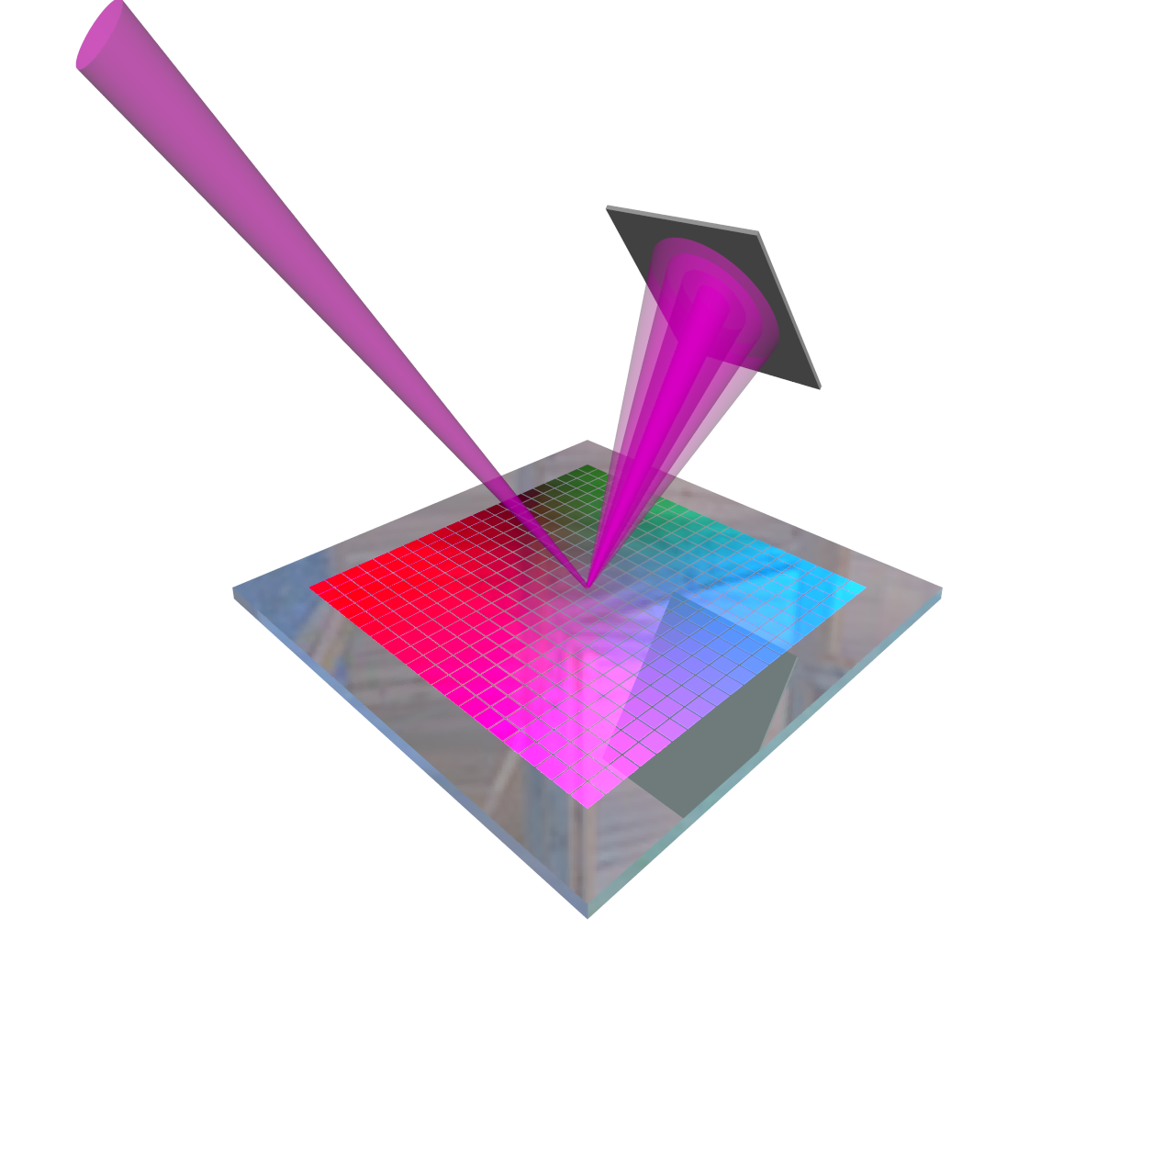
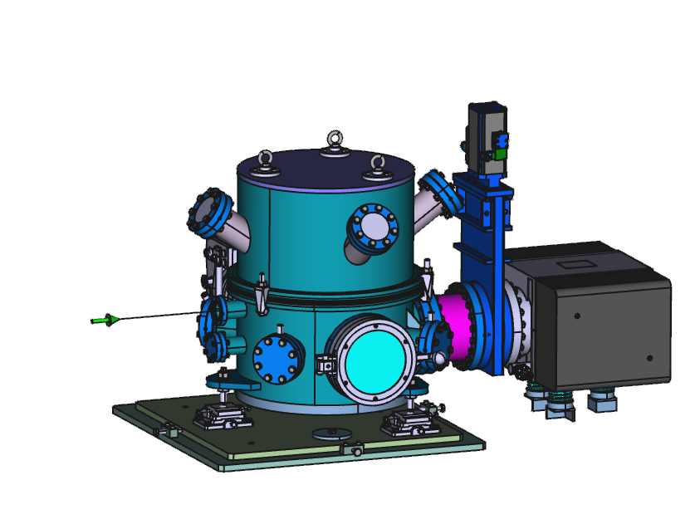
RESCAN
Actinic pattern inspection platform based on Coherent Diffraction Imaging (CDI)
Coherent EUV
illumination
Detector
Synchrotron-based
Tunable wavelength
  EUV optimized
λ/∆ λ ≈ 1500
Max sample size: 2×2 cm²
Inspection area: 200x200 μm²
Na_{max}: 0.24
Resolution limit: 34 nm
EUV reticle
Compact vacuum chamber
XIL-II beamline SLS

Slide 4
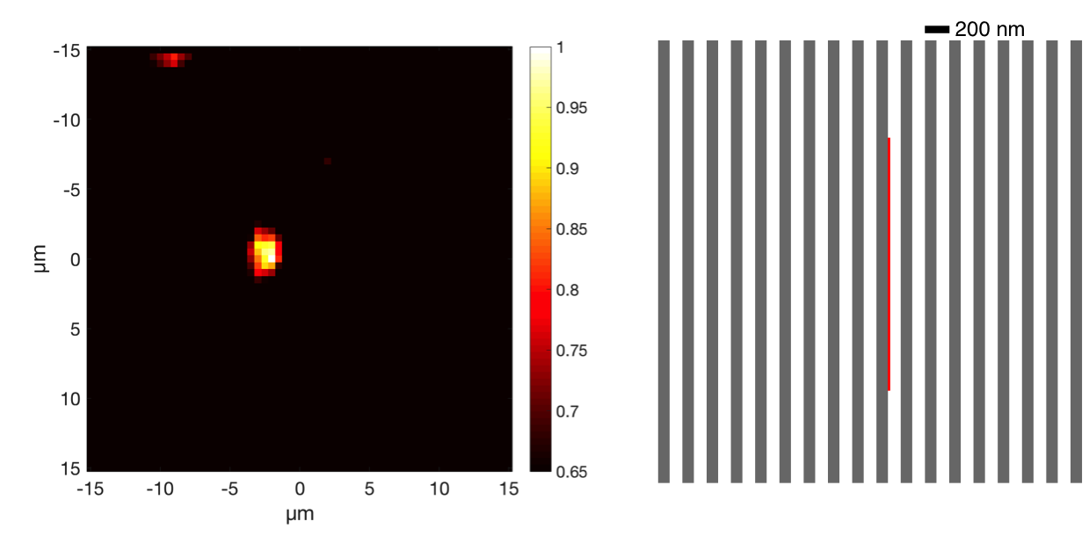
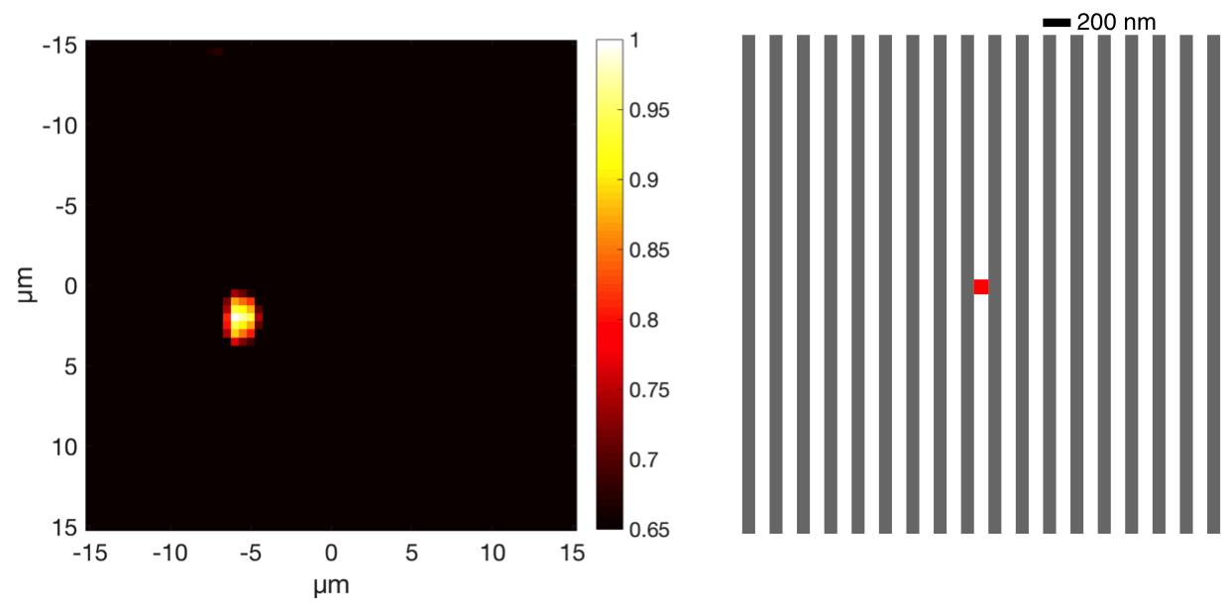
Current results – defects on periodic patterns
Defect inspection on periodic patterns based on coherent scattering
SNR: 6.9
SNR: 7.1
Non periodic structures are more challenging for a simple approach based on coherent scattering.
Iacopo Mochi et al. (2017). RESCAN: an actinic lensless microscope for defect inspection of EUV reticles. Journal of Micro/Nanolithography, MEMS, and MOEMS, 16(4), 041003–041003.
Notes:
Therefore we use CDI… and specifically ptychography

Slide 5
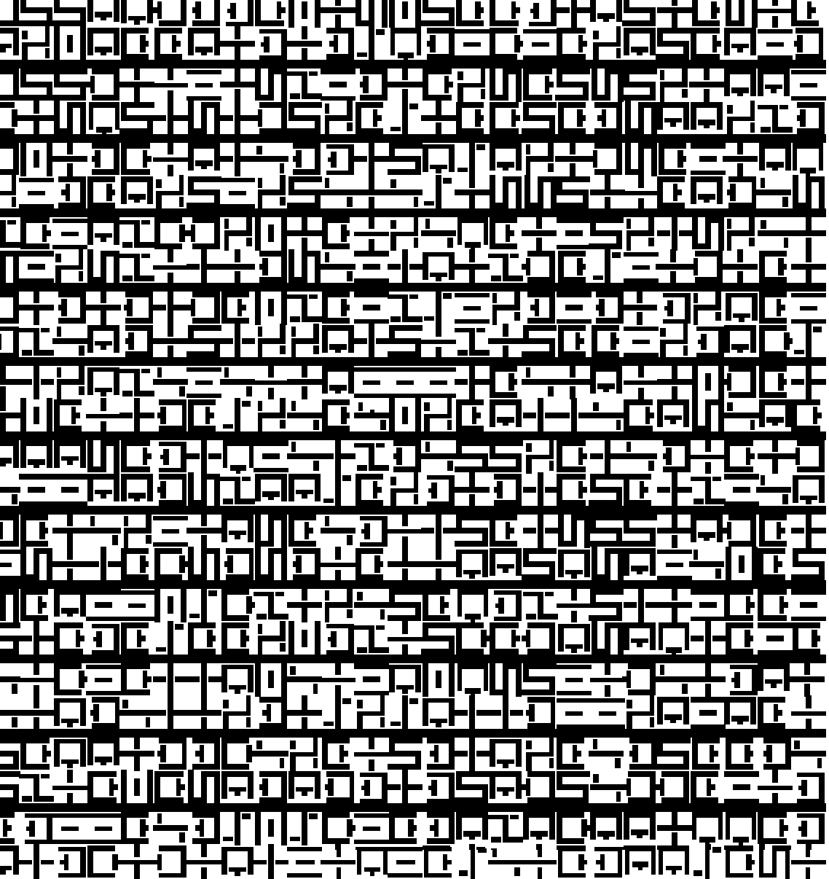
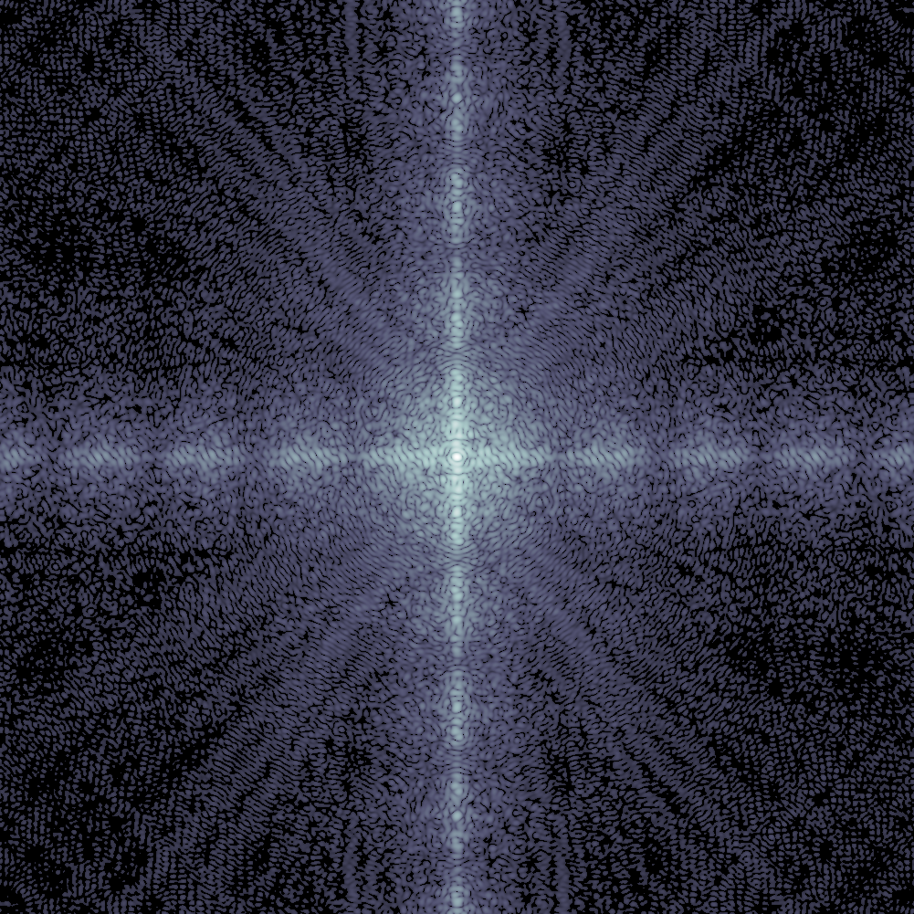
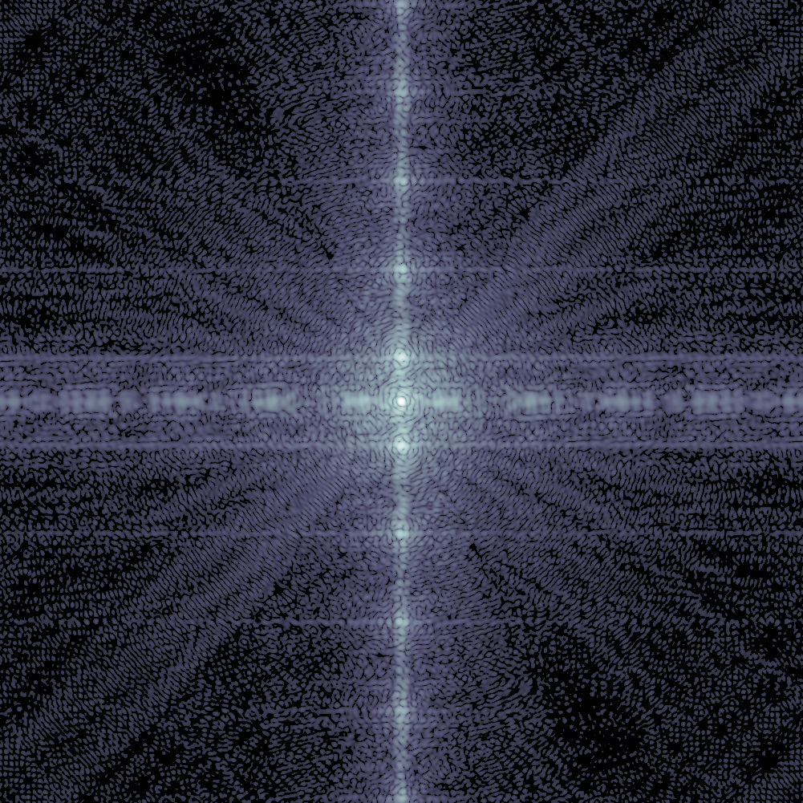
How does ptychography work?
The phase of the far field diffraction pattern is not recorded.
Ptychography iteratively searches for a common solution to the inverse problem in the overlapping area

Slide 6
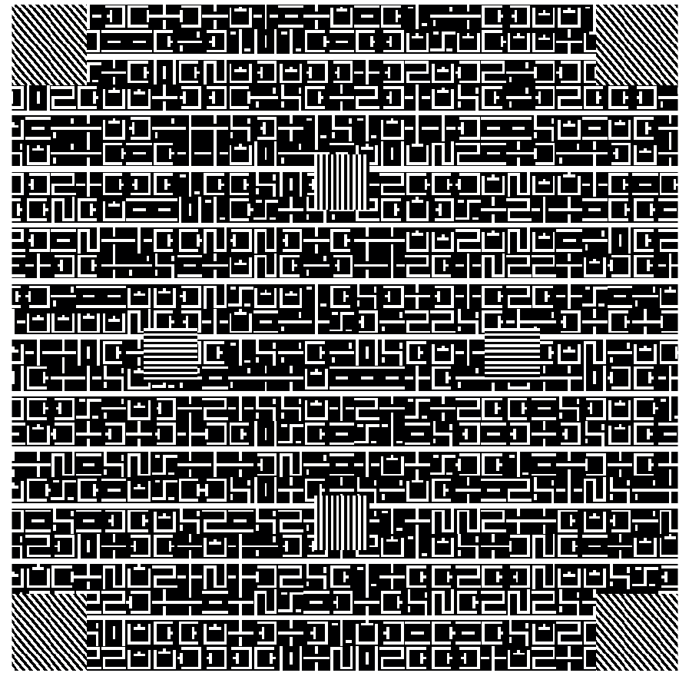
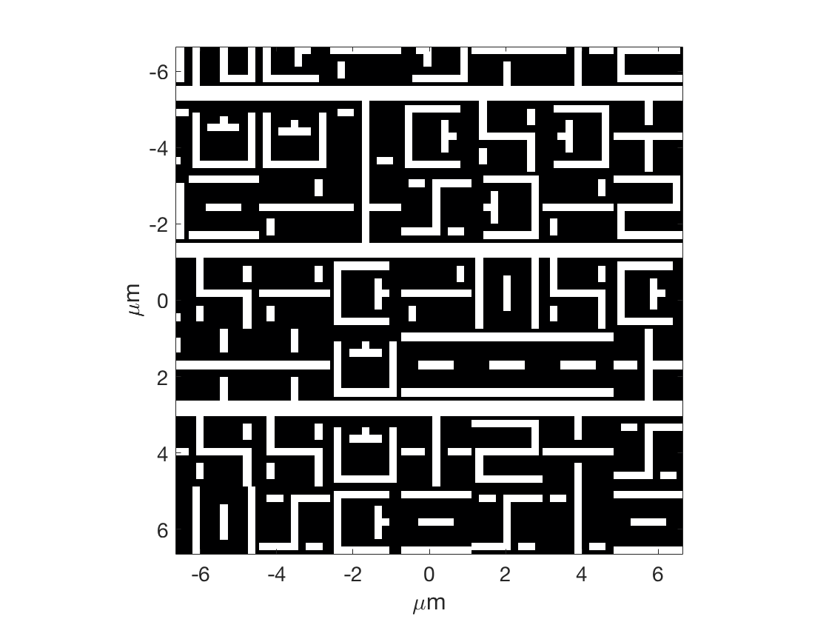
Programmed defect in a random pattern
Variable size extrusion defects
Pattern CD: 200 nm (on mask)

Slide 7
Programmed defect sample
Dark-field sample with programmed extrusion defects.
Silicon substrate.
MoSi multilayer: 40 bi-layers.
HSQ absorber.
Thickness: 145 nm.
Defect size on mask
200×200 nm extrusion.
200×150 nm extrusion.
200×100 nm extrusion.
200×50 nm extrusion.
50.5 nm
151.3 nm
201.8 nm
100.9 nm
200 nm

Slide 8
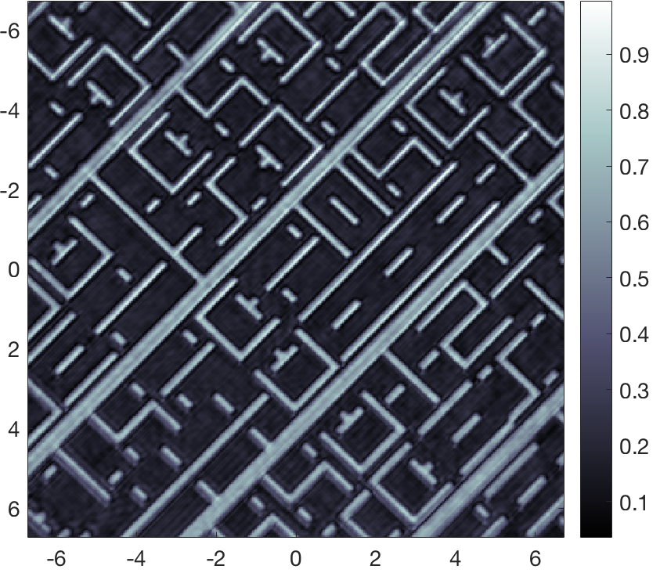
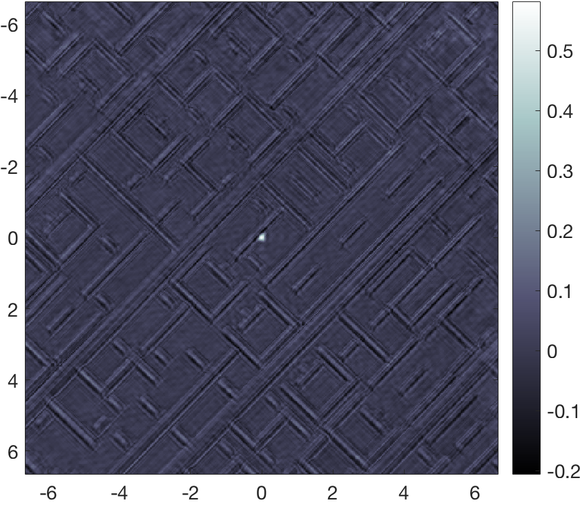
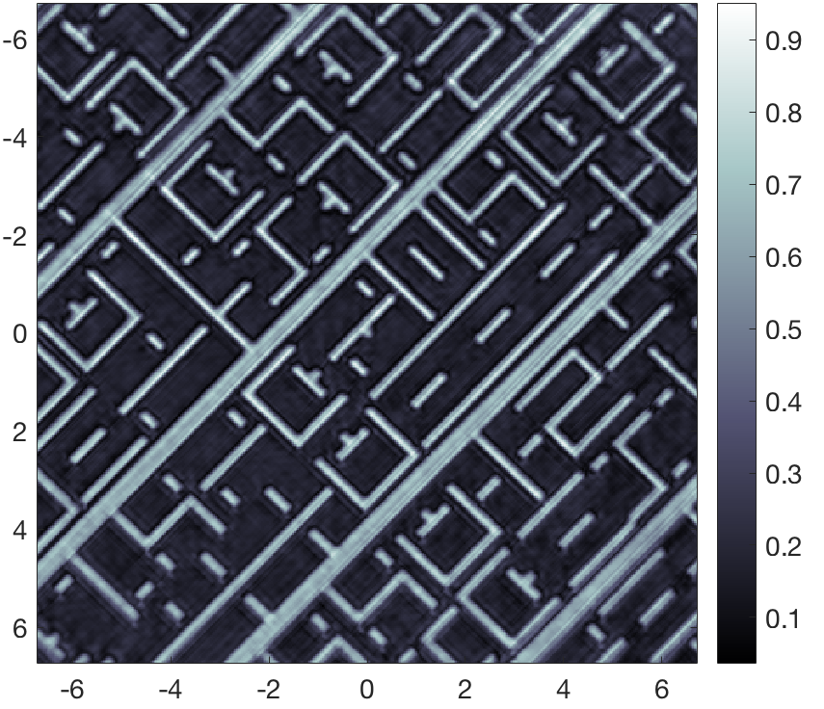
Pattern comparison for accurate defect localization
Die to die defect inspection:
comparing a defect free area of the sample to a defective one.
200-nm extrusion
Reference
Defect map
Reconstructed area: 20×20 μm².
Average iteration time: 80 ms.
Defect SNR: 15
μm
μm

Slide 9
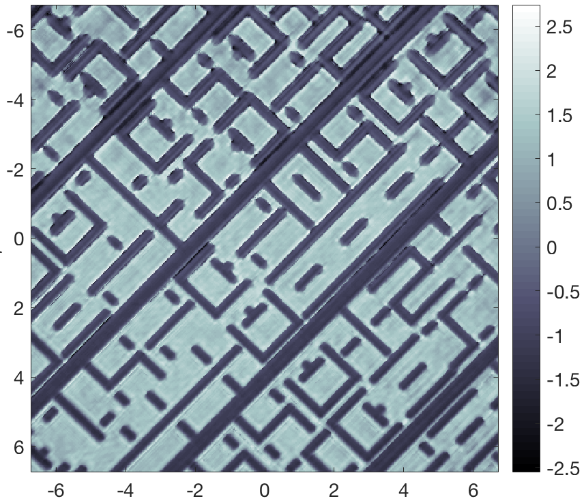
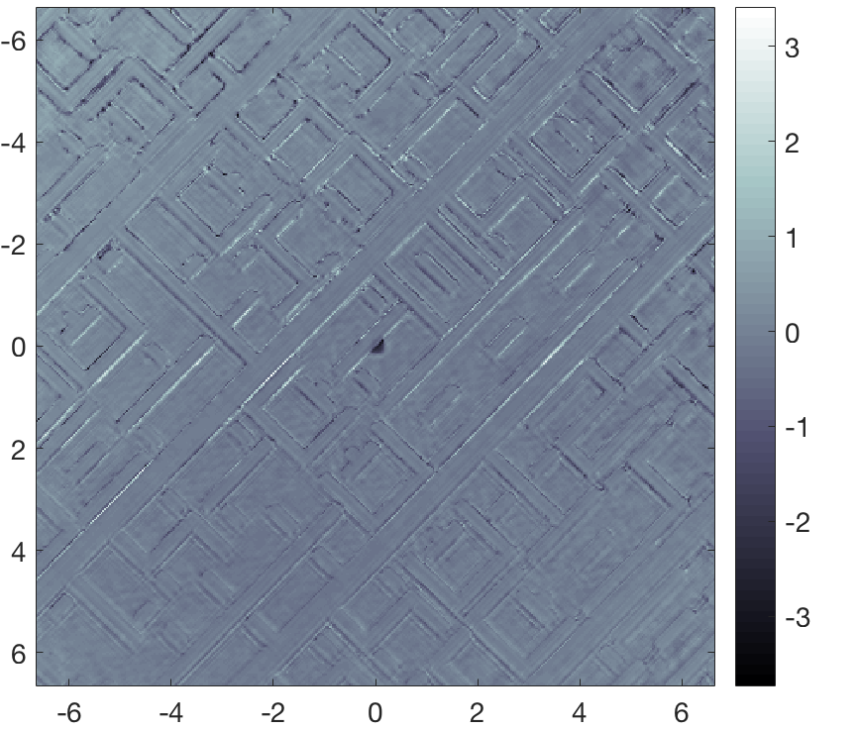
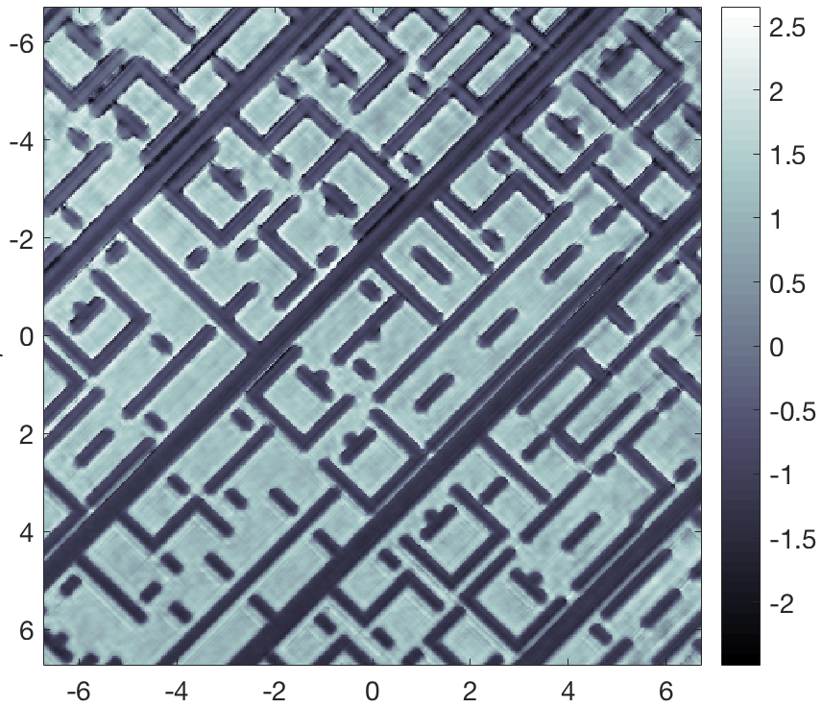
Pattern comparison for accurate defect localization
Defect phase map
Reference
200-nm extrusion
Defect map
Strong phase contrast
Binary phase
rad
rad
μm
μm

Slide 10
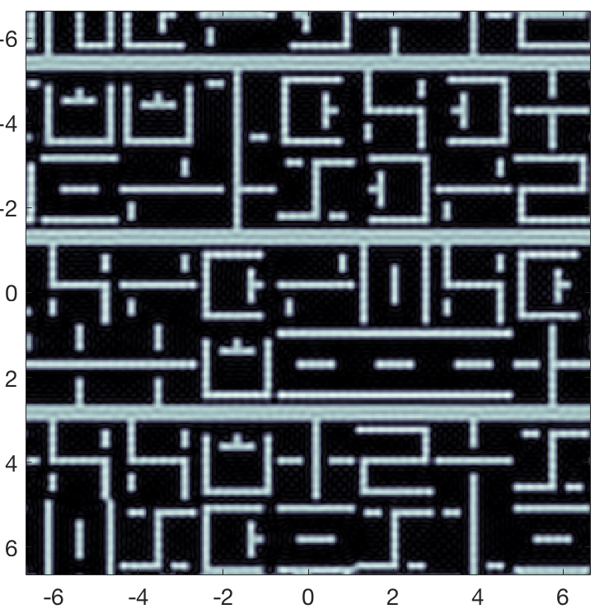
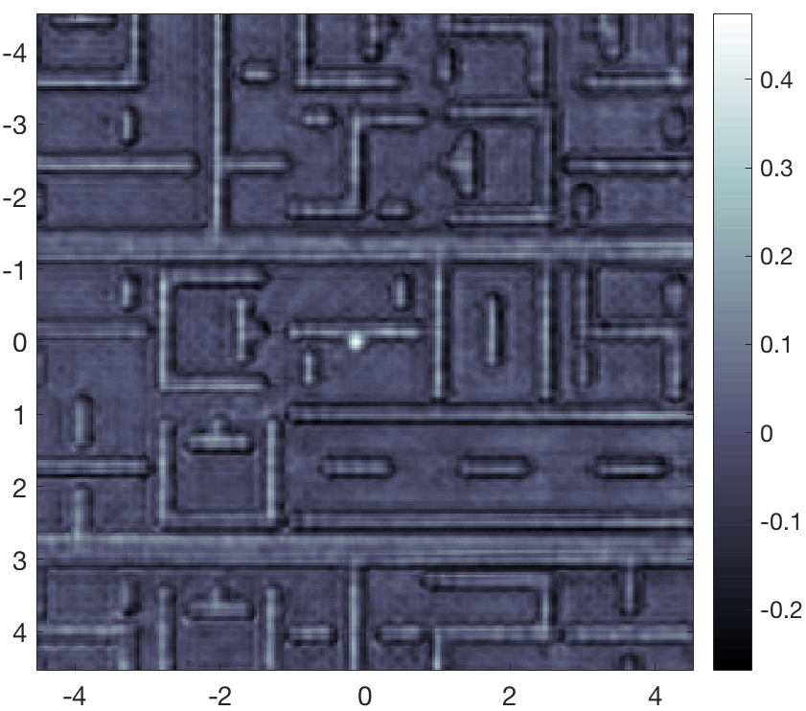
A practical approach: die to database inspection
Comparison between reconstructed image and mask design.
200×200 nm² extrusion defect.
Mask layout
Ideal mask image
Reconstructed amplitude image
Defect map
Apply spatial frequency filter to reticle design.
Calculate the best fitting affine transformation matrix.
Align and compare the images
μm
μm

Slide 11

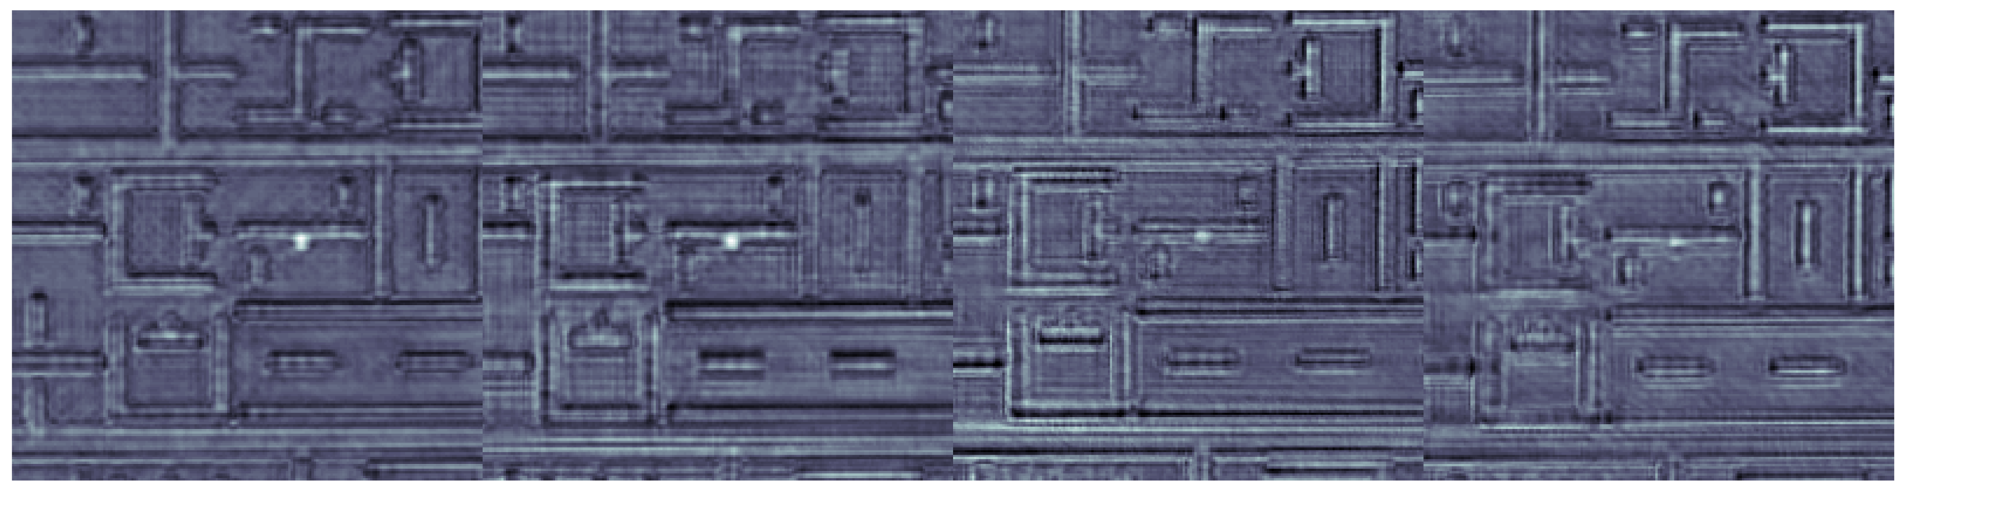
Close to the resolution limit
Defects down to 50 nm (on mask) are detected with a significant SNR.
The current resolution limit of RESCAN is 34 nm.
200 nm – SNR 7.3
150 nm – SNR 6.2
100 nm – SNR 5.2
50 nm – SNR 6.5
μm
μm
μm
μm
Notes:
To help the defect visualization we can threshold and binarize the images.

Slide 12
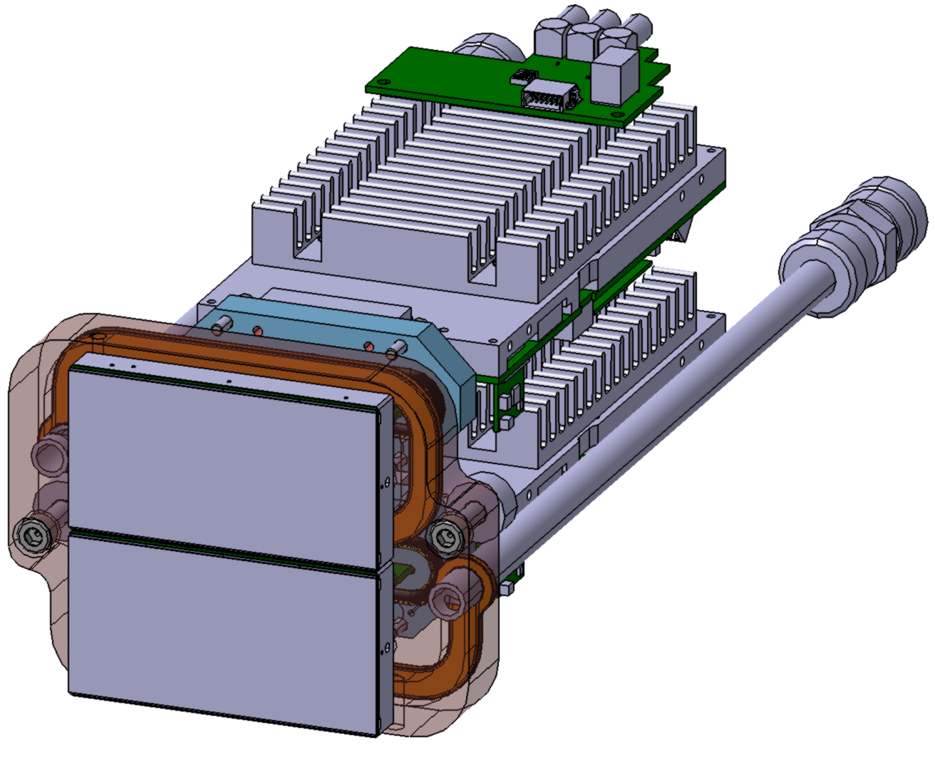
Planned upgrades and roadmap
From EUV CCD to two-modules EUV-optimized JUNGFRAU detector. (10/2017)
EUV CCD
JUNGFRAU
Pixel number: 2048×2048
Pixel number: 1024×512 (1 module)
Pixel size: 13.5 μm.
Pixel size: 75μm.
Acquisition frame rate: 1 Hz.
Acquisition frame rate: 2000 Hz.
Dynamic range: 16 bit
Dynamic range: 20 bit.
NA: 0.24
NA: 0.4
Large dynamic range
Single acquisition and short exposure time (0.01 s).
High NA
Resolution limit down to 20 nm.
JUNGFRAU and COSAMI: Detector and source technologies for high-throughput EUV mask inspection, Rajeev Rajendran et al. [10451-49]

Slide 13
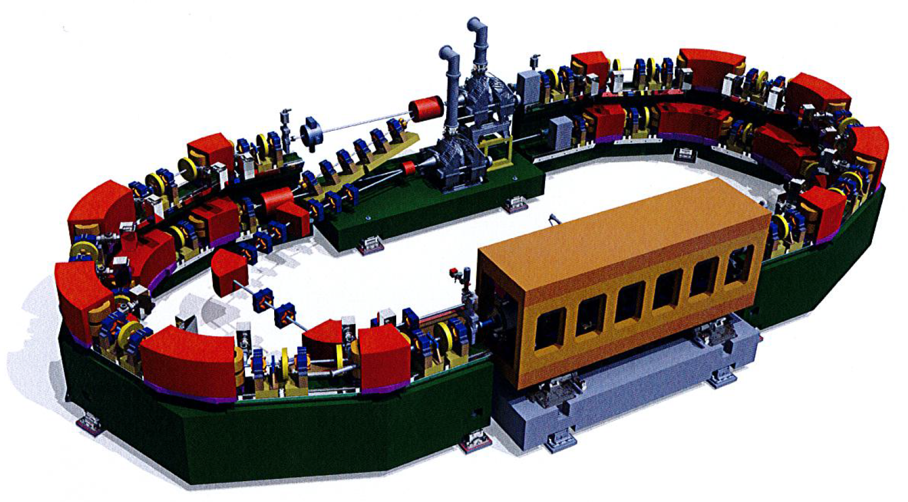
Planned upgrades and roadmap
Improved reconstruction code. (02/2018)
GPU integration for ptychography reconstruction.
Aerial image simulation for accurate die to database inspection.
COmpact Source for Actinic Mask Inspection
Wavelength | 13.5 nm
Flux | >100 mW
Brilliance | > 10⁶ W/mm²⋅strd
Beam Energy | 430 MeV
Beam Current | 150 mA
Pulse Structure | ~50 ps every 2 ns
Injection mode | Top-up mode
Foot print | 5m × 12m
JUNGFRAU and COSAMI: Detector and source technologies for high-throughput EUV mask inspection, Rajeev Rajendran et al. [10451-49]

Slide 14
Summary
RESCAN latest results and upgrades
RESCAN can effectively map programmed defects on periodic and non periodic patterns.
Die-to-die and die-to-database inspection modes are available.
We demonstrated defect inspection down to 50 nm (on mask) with a high SNR.
10/2017
We are upgrading RESCAN with a high NA detector that will enable defect inspection down to 20 nm.
02/2018
We are upgrading the software to improve the reconstruction speed and stability.

Slide 15
Wir schaffen Wissen – heute für morgen
Acknowledgements
Michaela Vockenhuber
Marcus Kropf
Luca Bühlmann
Zuhal Tasdemir

