Slide 1
Lensless Actinic Inspection of EUV Reticles with RESCAN
I. Mochi¹, P. Helfenstein¹, R. Rajendran¹, I. Mohacsi¹, Y. Ekinci¹, S. Yoshitake²
¹Paul Scherrer Institut. ²NuFlare Technology, Inc.
EUVL symposium 2016

Slide 2
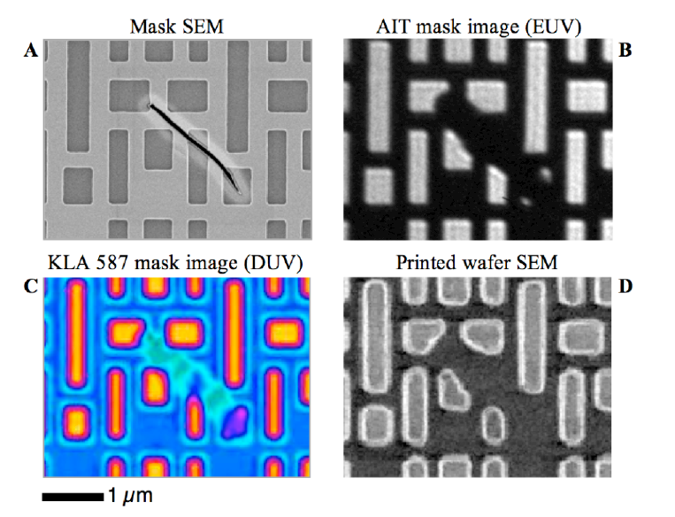
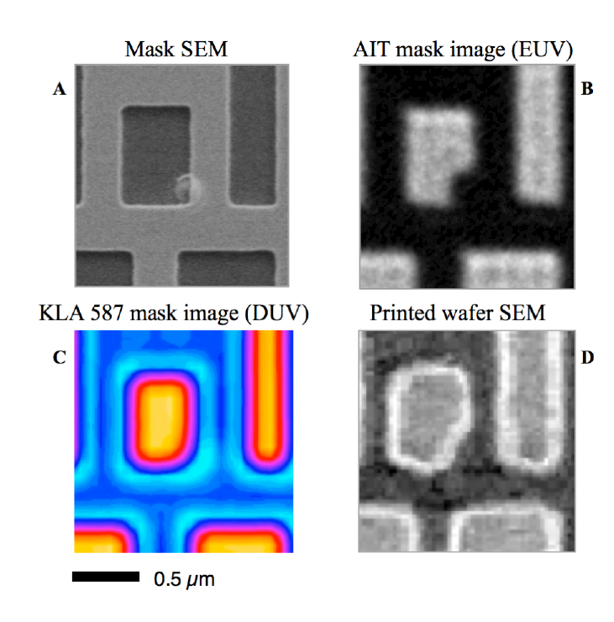
EUV reticle inspection for N7 and beyond
  No actinic patterned reticle inspection platform available for industrial use
  Actinic inspection is the most accurate approach for the detection and characterization of defect on EUV reticles.
Reticle SEM
AIT EUV image
DUV image
Wafer SEM
1 μm
0.5 μm
I. Mochi et al. Proc. Of SPIE Vol. 7636 76361A-1

Slide 3
OUTLINE
Introduction to the RESCAN project
Coherent diffraction
Defect detection and localization
Experimental results
Low resolution defect map
Defect area image reconstruction
Rescan recent upgrades
A faster detector
Dedicated beamline
What’s next

Slide 4
What is RESCAN?
  An actinic inspection platform for the localization and classification of defects on EUV reticles @ SLS synchrotron.
  Based on coherent scattering methods
  Target specifications:
  Defect resolution: 10 nm
  Inspection throughput: 7h/reticle

Slide 5
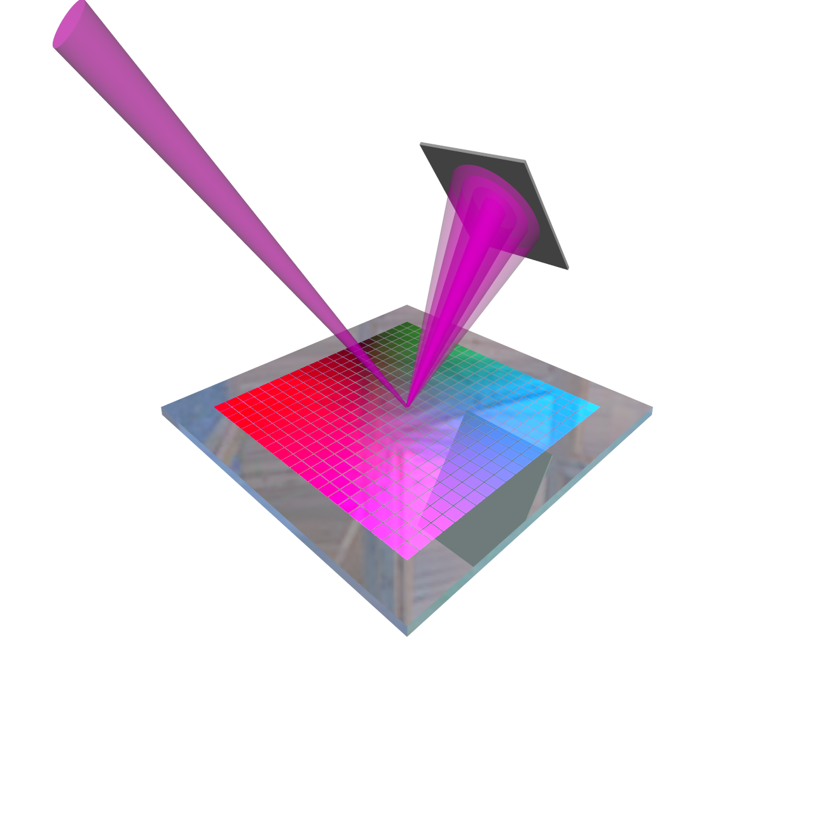
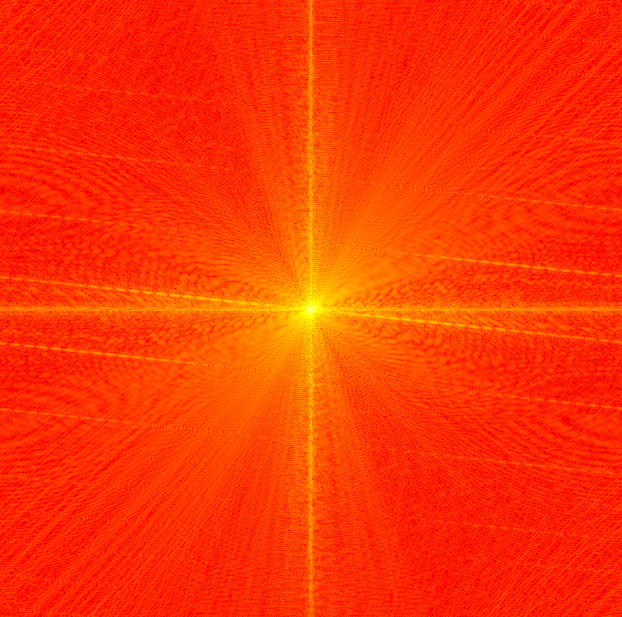
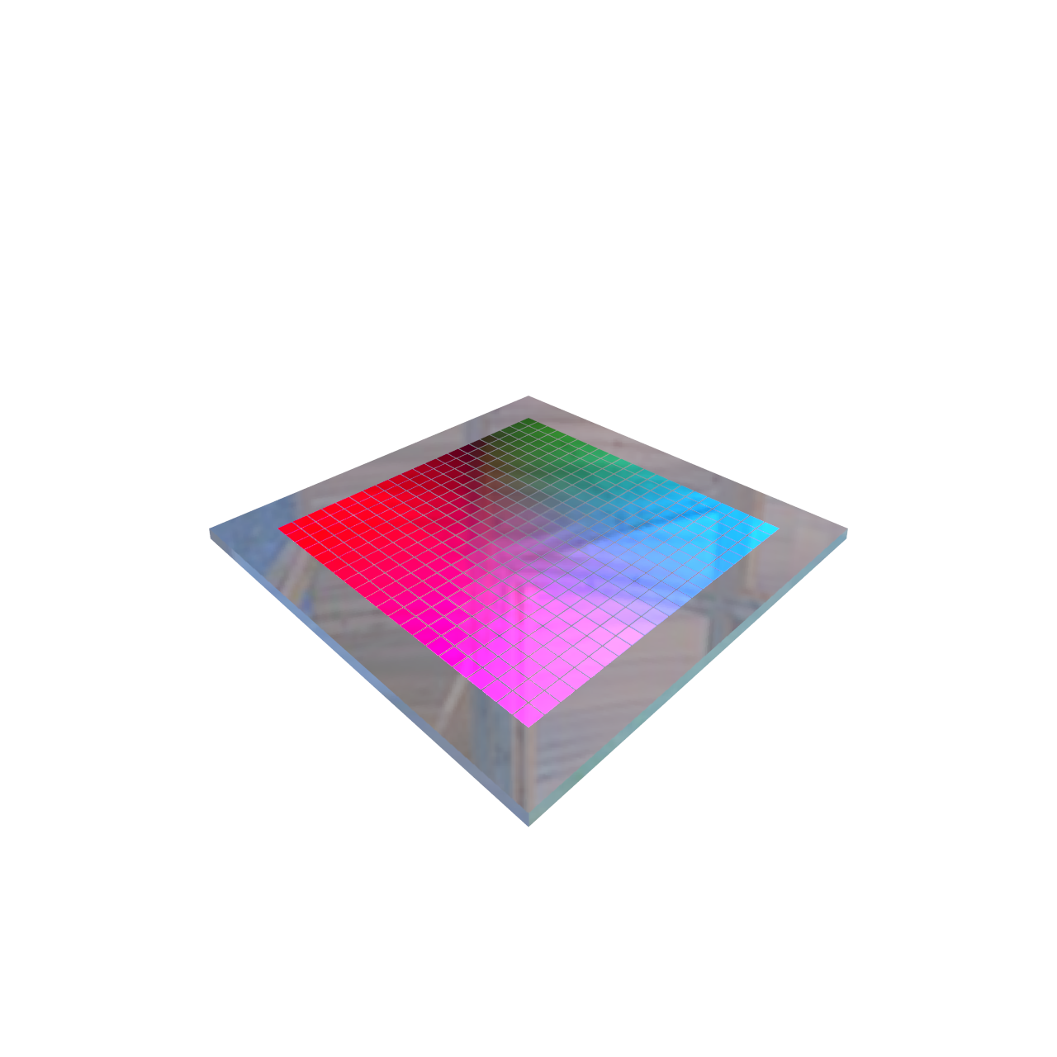
How does RESCAN work?
COHERENT SCATTERING
Detector
Coherent
illumination
Diffraction pattern
EUV reticle

Slide 6
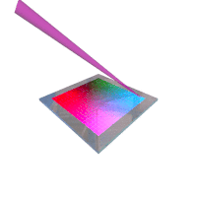
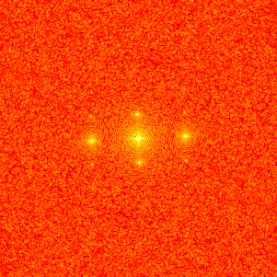
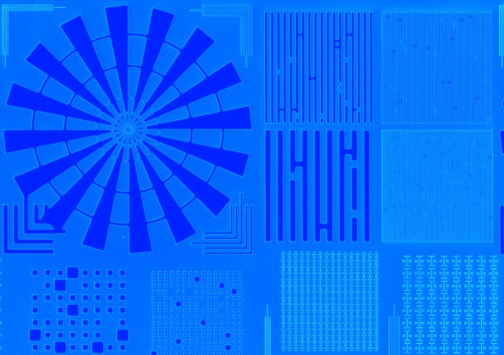
A TWO-STEP PROCESS
THE DEFECTS ARE DETECTED AND LOCALIZED IN TWO STEPS
1. Fast mask scanning with variable-size probe
Diffraction pattern
analysis
2. Aerial image reconstruction of defect zone
CDI
reconstruction

Slide 7
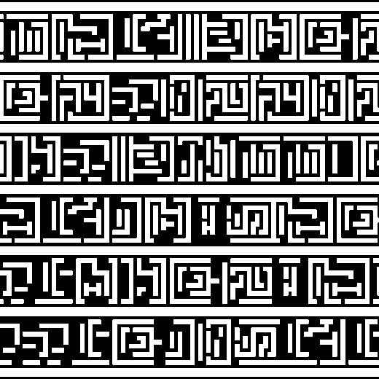
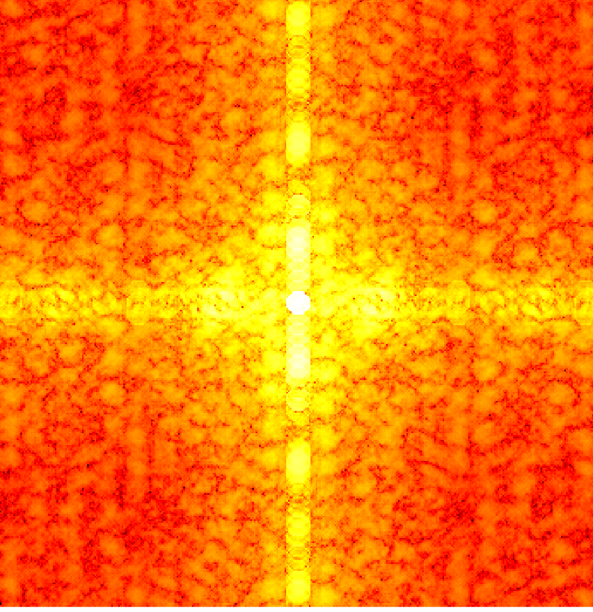
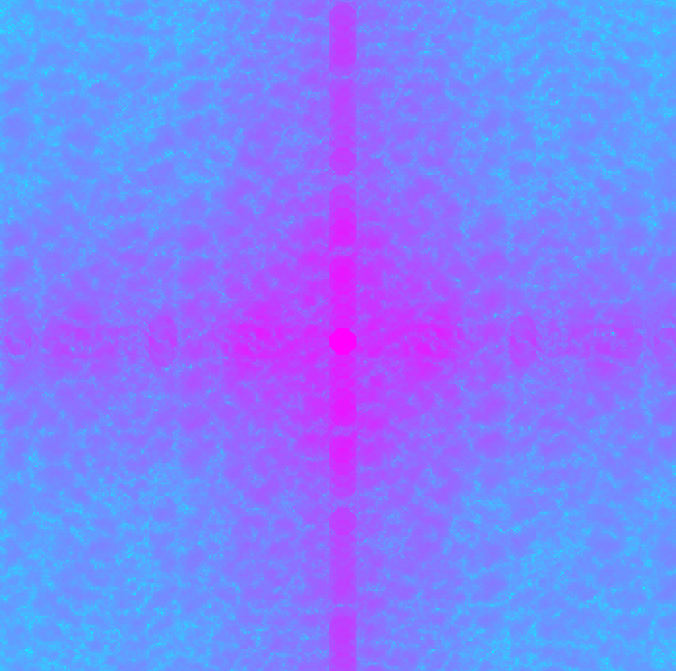
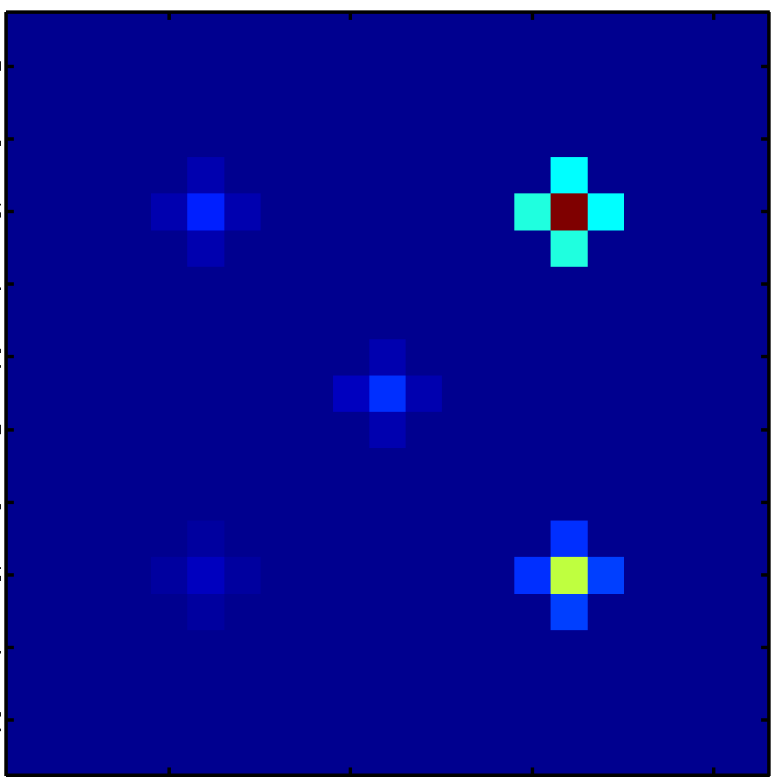
Defect identification
Diffraction intensity
Recorded
Reticle GDS
Calculated
Reference die
Die to database comparison.
Die to die comparison.
High sensitivity.
Defect multiple detection.
Fast mask scan.
On the fly defect detection.
Low-resolution
defect map

Slide 8
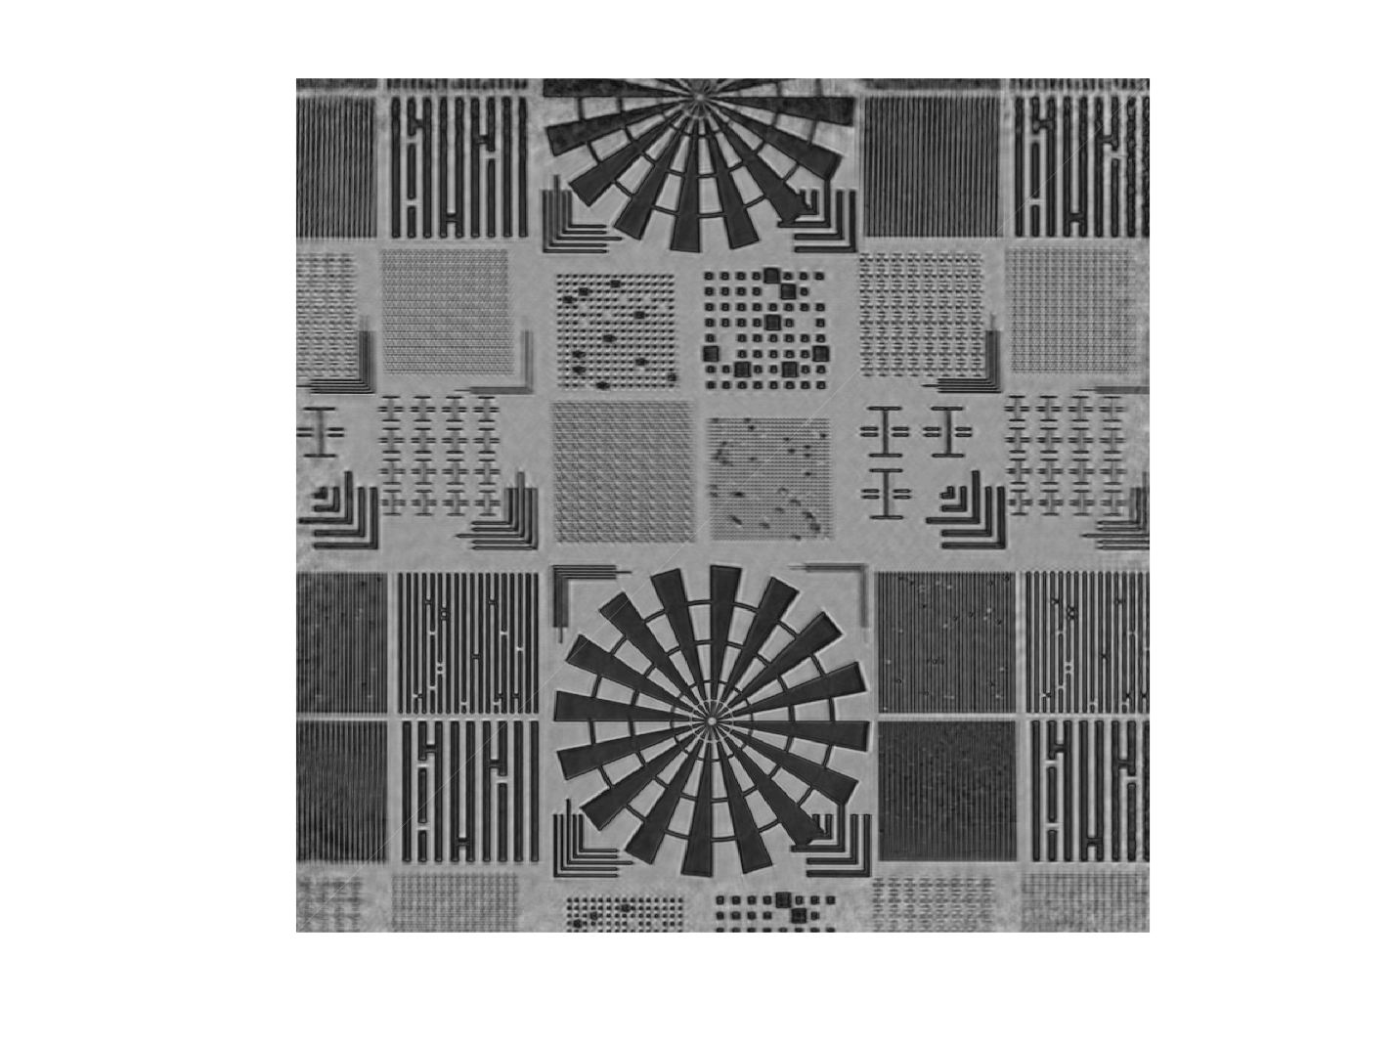
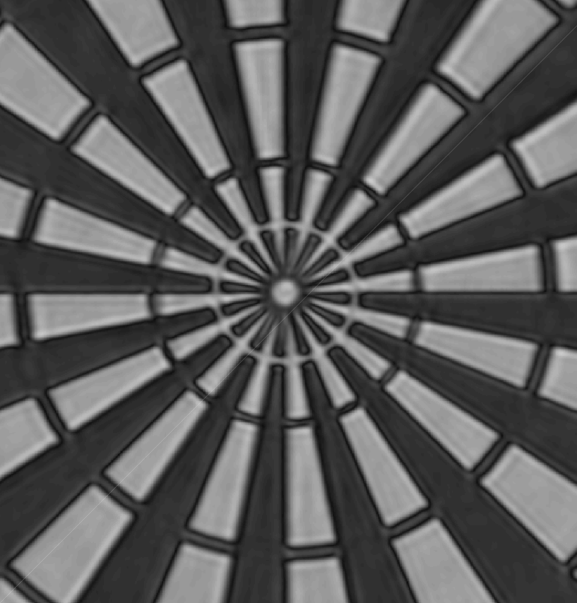
Defect localization
Aerial image reconstruction with coherent diffraction imaging.
Iterative process.
Noise robust.
Magnitude and phase reconstruction.
0.5 μm
P-MA-06 Dr. P.Helfenstein Actinic EUV Mask Metrology with RESCAN using a monochromatic beam.

Slide 9
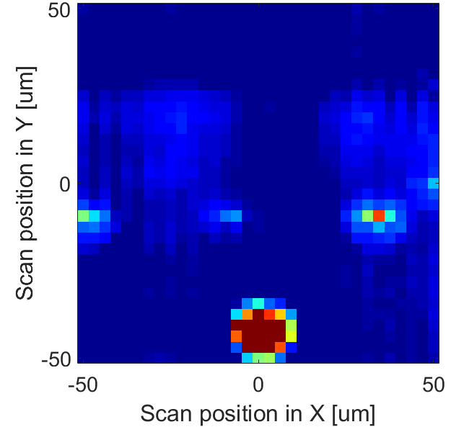
Defect detection– experimental results
25 nm hp grating
-40 x 2000 nm²
CD error
+40 x 2000 nm²
CD error
Large added particle
Page 9

Slide 10
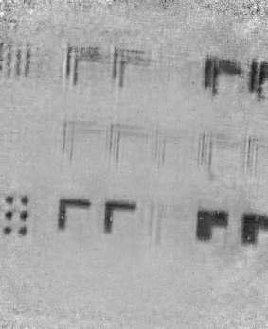
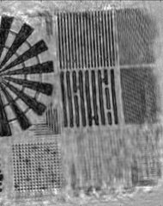
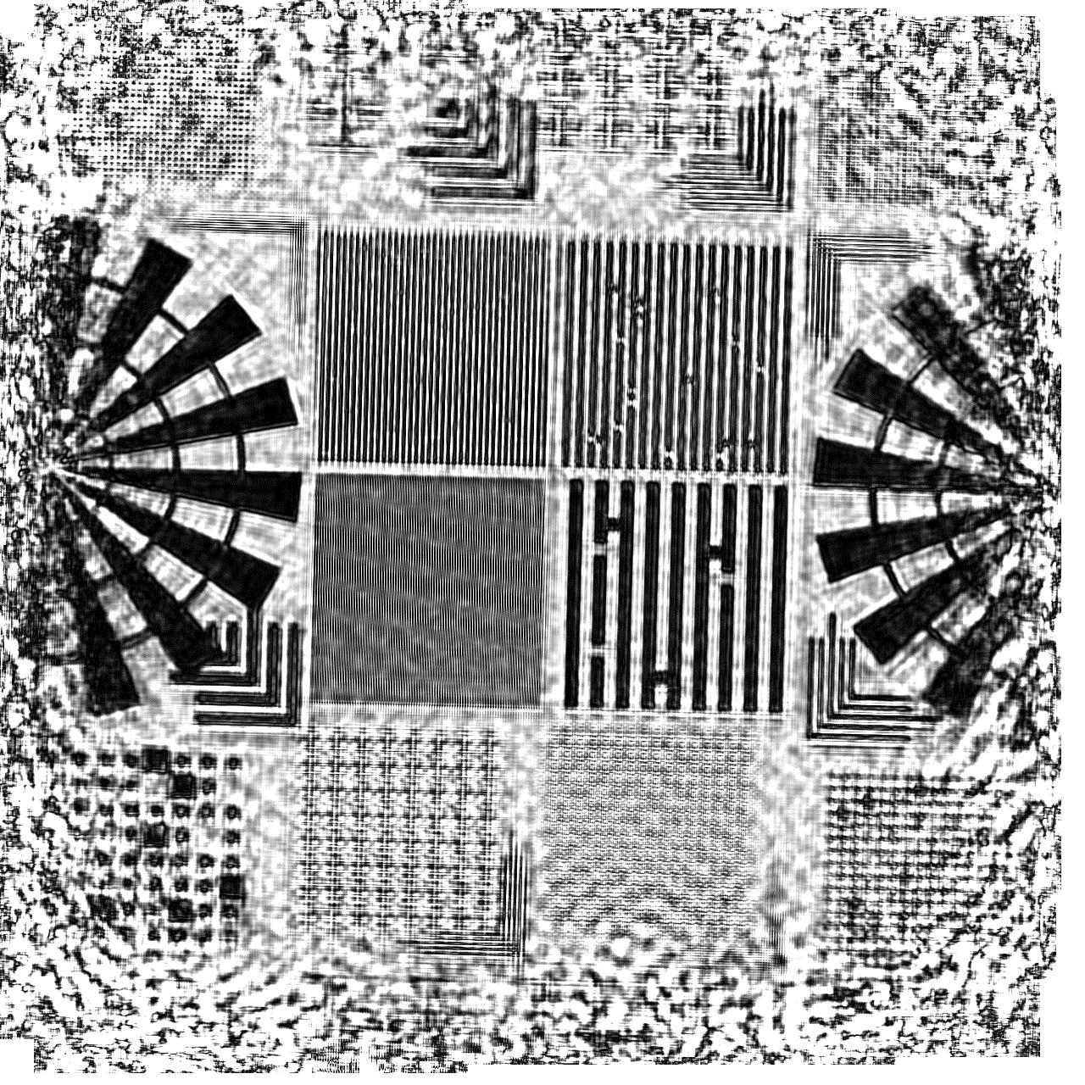
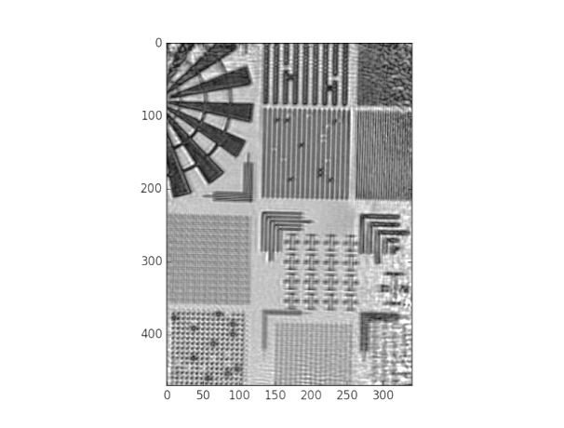
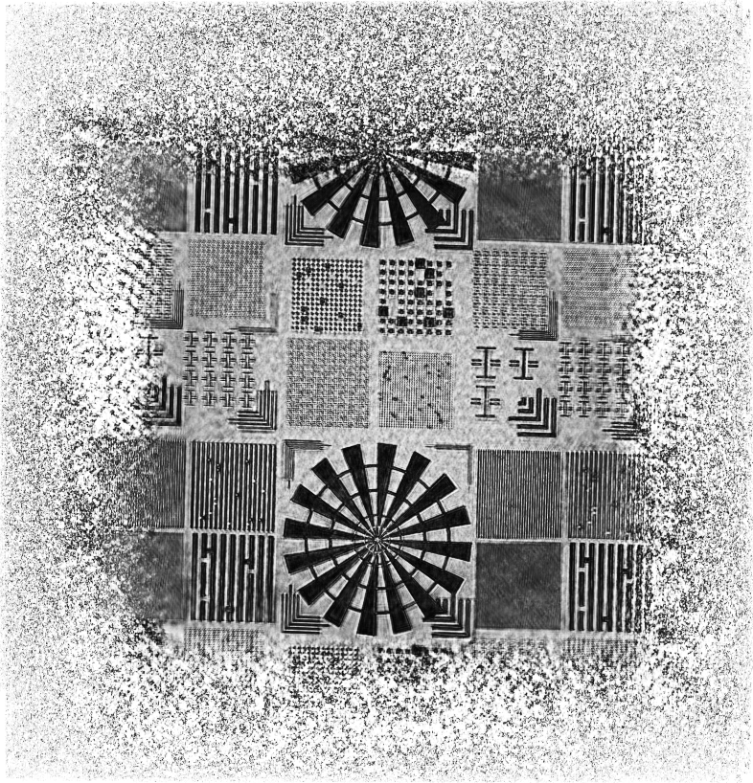
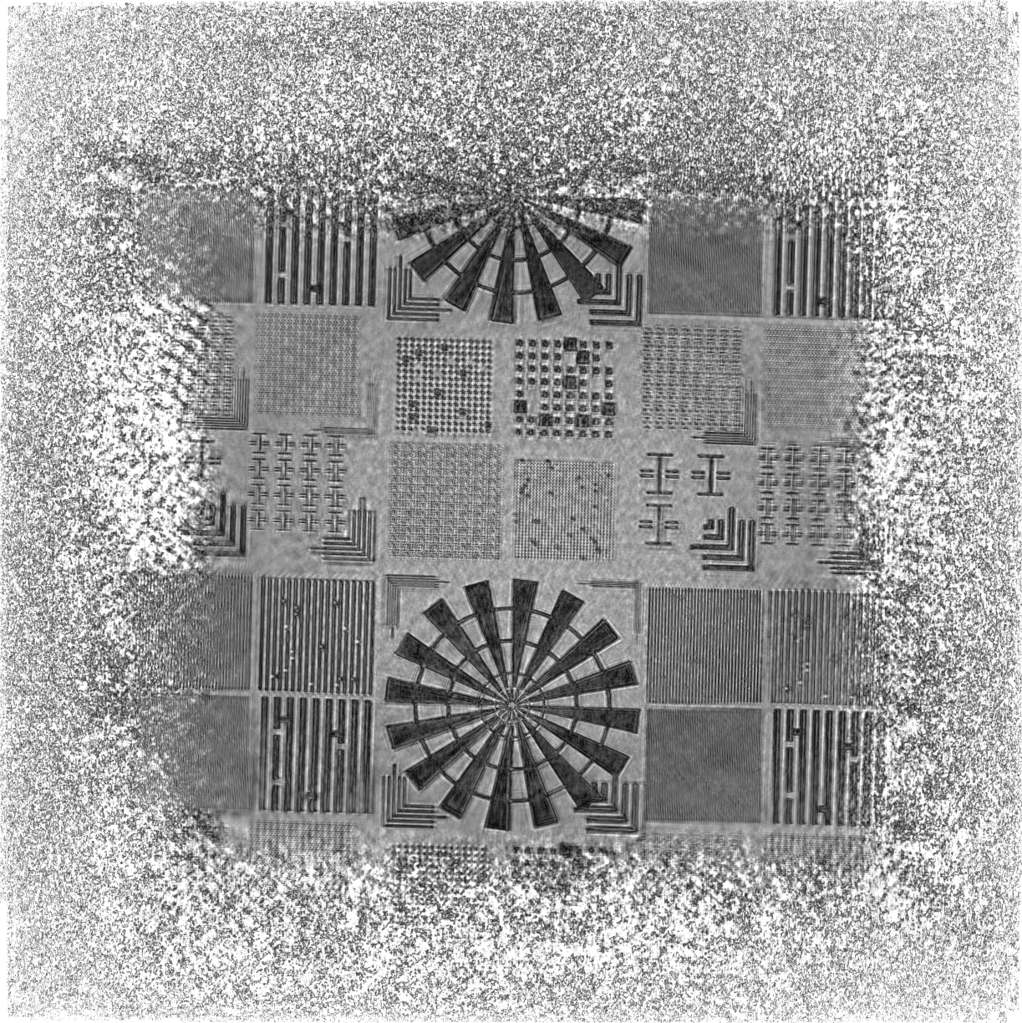
Defect localization – experimental results
Reconstruction algorithm optimization
RESCAN 1
Artifact reduction.
Resolution enhancement.
Field of view increase.
October 2015
February 2016
RESCAN 2
May 2016
June 2016
July 2016
August 2016

Slide 11
Defect localization – experimental results
100 nm CD lines with programmed and native defects
Amplitude map
Amplitude modulation

Slide 12
Defect localization – experimental results
Phase contrast is also useful for defect identification.
SEM image
Phase map

Slide 13
Looks promising but…
There are two main challenges for successful implementation:
1. Detector dynamic range
2. Full mask inspection time
How much time does it take to scan a 100×100 mm² area with a 30 μm diameter probe?
Detector max
Intensity typ. 3000 ph
We need at least 50% overlapping
100×100 mm² / 0.015×0.015 mm²
Defect signal level
Noise level
44000000 images!
Requires ~1800 Hz frame rate
Low intensity – Signal buried in noise
High intensity – Peak saturation

Slide 14
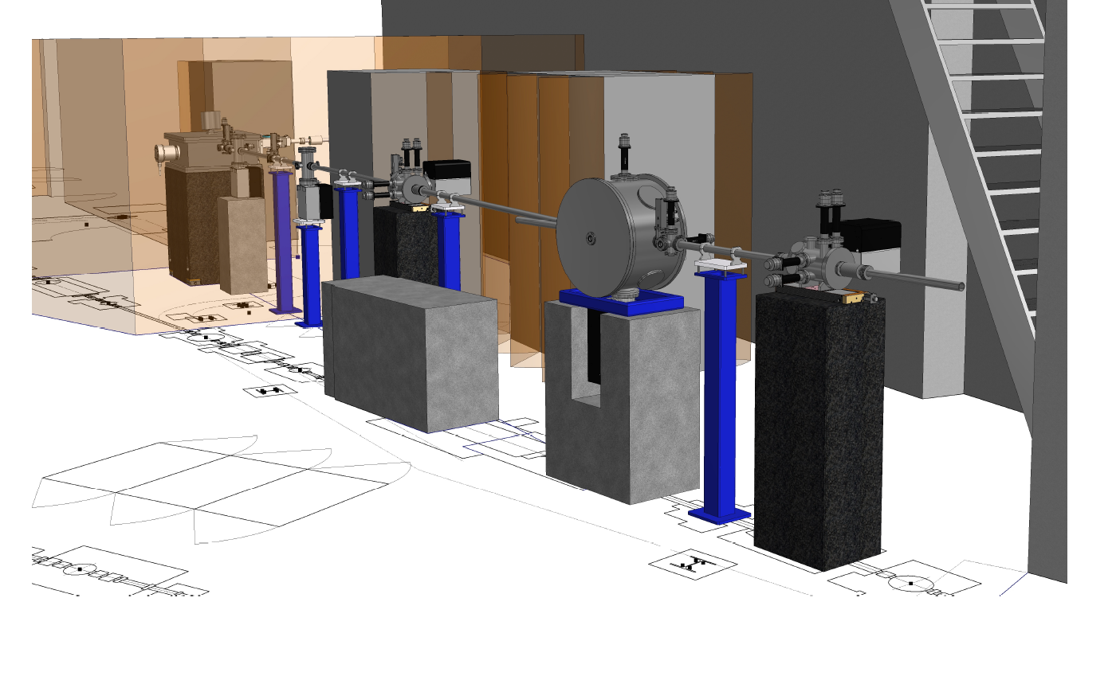
RESCAN dedicated beamline at SLS
Designed and optimized for RESCAN
Wavelength: 4 -14 nm
Photon rate: 10¹¹ -10¹² Ph/s (Coherent flux on sample)
Monochromaticity: 2000

Slide 15
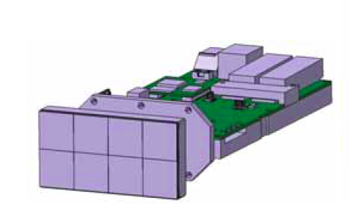
A –very– fast detector
JUNGFRAU 0.2 – Developed at PSI for hard X-Ray applications (FEL)
Dynamic range | >10⁶ (20 bit)
Module size | 80mm X 40mm
Pixel size | 75 microns
No of pixels | 512 × 1024
Acquisition Rate | 2000 Hz
Pixel Bleeding | No in both directions
JUNGFRAU 0.2
P-MA-03 Dr. R.Rajendran A high frame-rate pixel detector with extended dynamic range for EUV imaging and mask metrology.

Slide 16
Defect inspection at 500 Hz
Recent data.
100 nm hp grating
Y position [μm]
A.U.
10 nm
CD error
X position [μm]

Slide 17
Multi-module detector
Jungfrau detector upgrade
Up to six independent modules. No decrease in acquisition speed.
EUV optimized. Quantum efficiency increases from 3% to 50%.

Slide 18
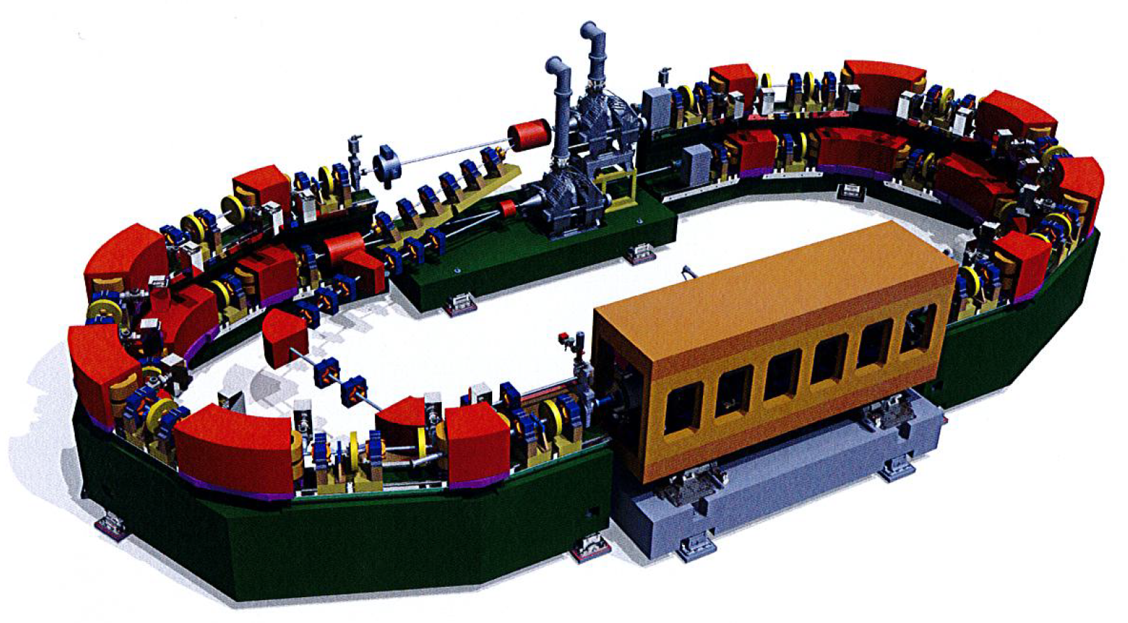
Compact EUV Metrology Source „COSAMI“
Wavelength | 13.5 nm
Flux | >100 mW
Brilliance | > 10⁶ W/(mm²⋅strd)
Beam energy/beam current | 430 MeV/150 mA
Pulse structure | ~50 ps every 2 ns
Injection system | Top-up mode
Footprint | 5m × 12m

Slide 19
Conclusion
The RESCAN platform can be a viable approach to fill the gap in actinic reticle defect inspection.
The key technology is available today.
Additional component development and integration is in progress:
Fast detector
Improved algorithms for inspection and image reconstruction
Compact EUV source

Slide 20
Wir schaffen Wissen – heute für morgen
We create knowledge – today for tomorrow
Aknowledgements
M. Vockenhuber
M. Kropf
J. Gabadinho
A. Mozzanica
S. Redford
B. Schmitt

