Slide 1
Actinic inspection of logic patterns using coherent diffraction imaging at high NA
Iacopo Mochi, Patrick Helfenstein, Rajendran Rajeev, Sara Fernandez, Dimitrios Kazazis and Yasin Ekinci

Slide 2
Outline
RESCAN – A platform for actinic pattern inspection
Description.
Working principle.
Latest performance highlights
Programmed defect detection on logic patterns.
Through-pellicle inspection.
Virtual through-focus mask inspection.
Resolution and throughput
Performance test of the EUV-optimized JUNGFRAU detector
Outlook and future plans

Slide 3
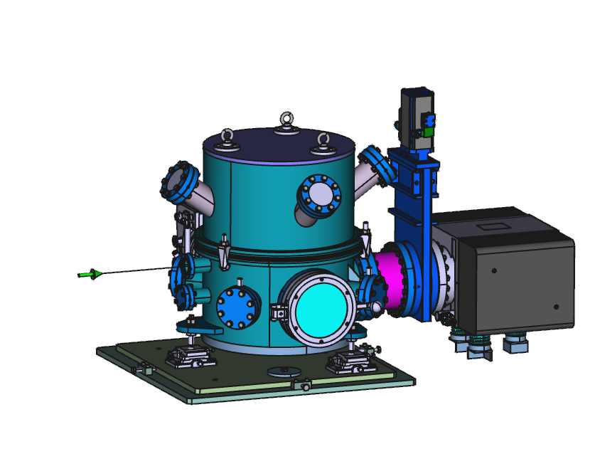
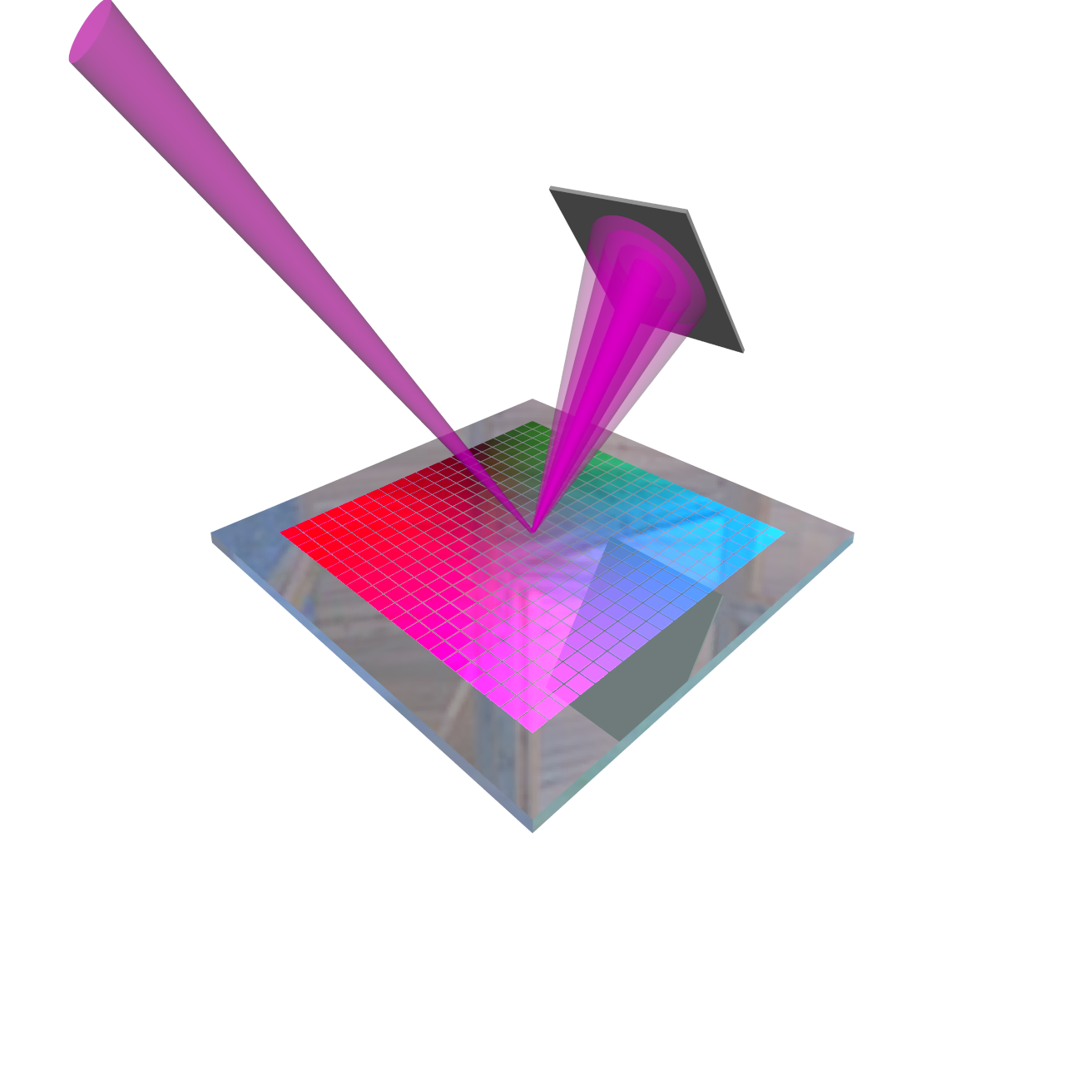
RESCAN
Actinic pattern inspection platform based on CDI
Coherent EUV
illumination
Detector
Synchrotron-based
Tunable wavelength
  EUV optimized
λ/∆ λ ≈ 1500
Max sample size: 2×2 cm²
Inspection area: 200x200 μm²
NA_{max}: 0.24
Resolution limit: 34 nm
EUV reticle
60 cm
Compact vacuum chamber
XIL-II beamline SLS

Slide 4
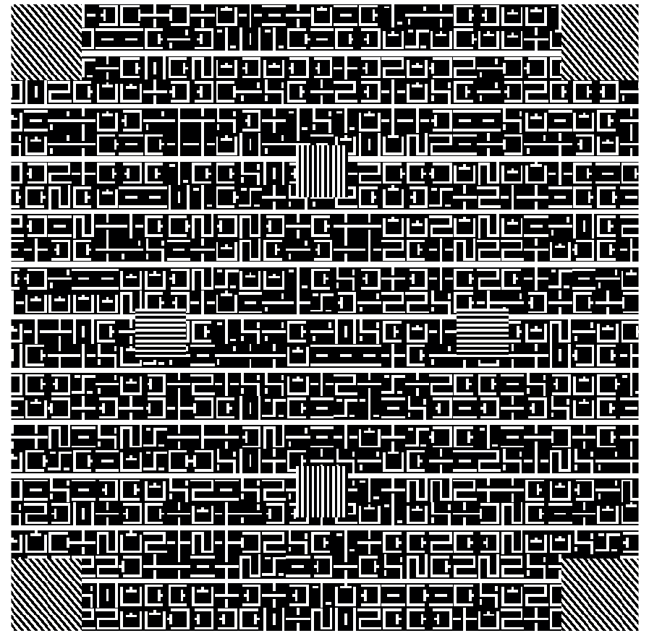
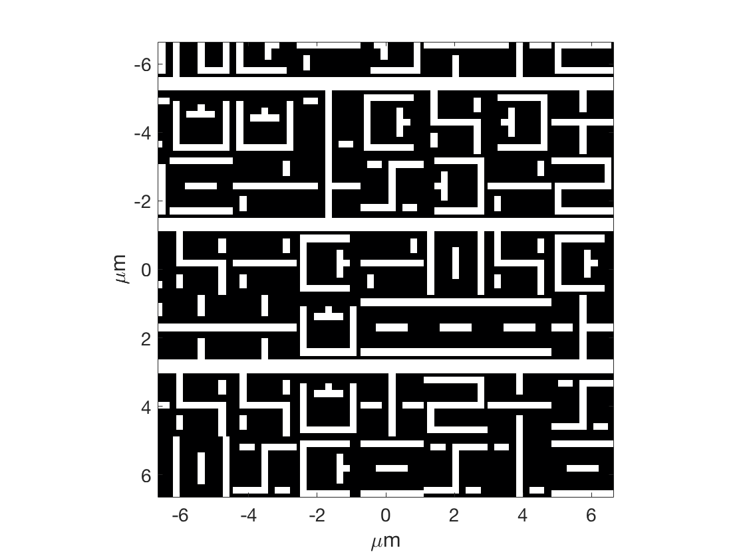
Programmed defect in a random pattern
Variable size extrusion defects
Pattern CD: 200 nm (on mask)

Slide 5
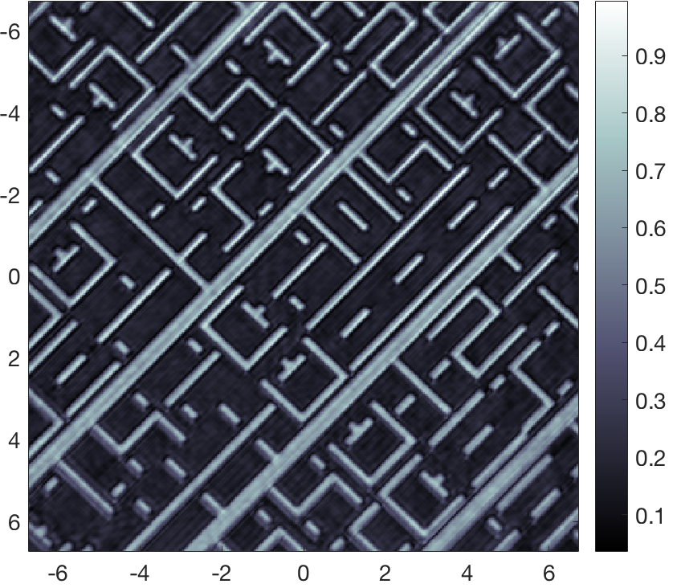
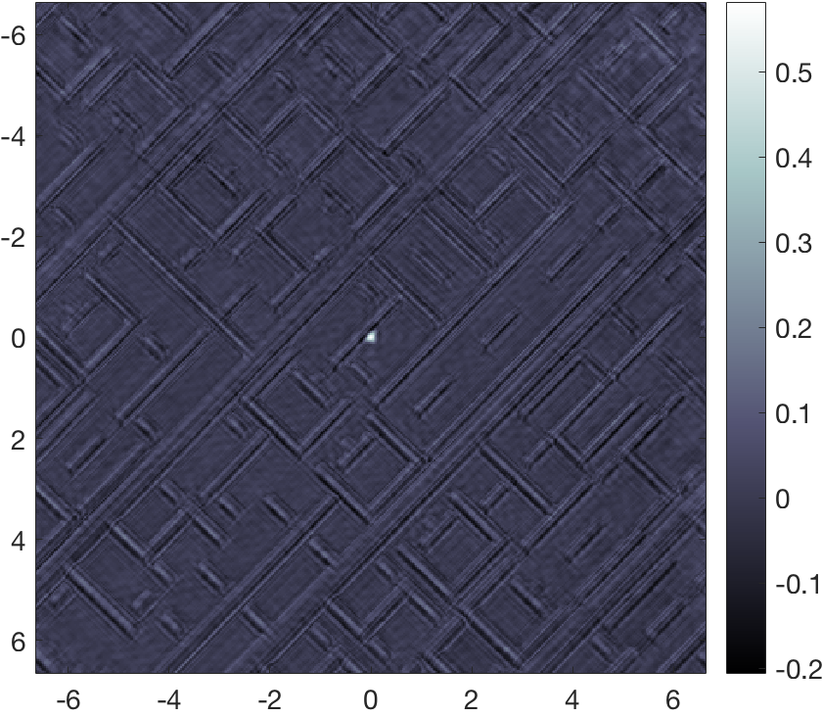
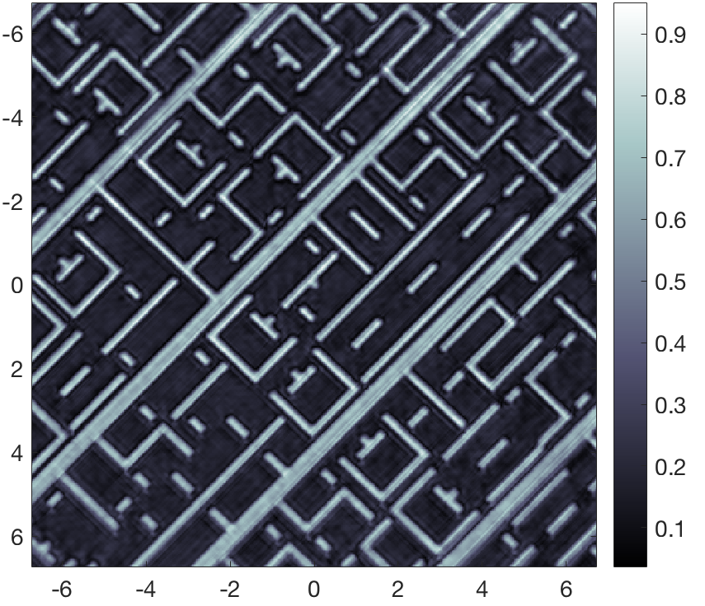
Pattern comparison for accurate defect localization
Die to die defect inspection:
comparing a defect free area of the sample to a defective one.
200-nm extrusion
Reference
Defect map
Reconstructed area: 20×20 μm².
Average iteration time: 80 ms.
Defect SNR: 15
μm
μm

Slide 6
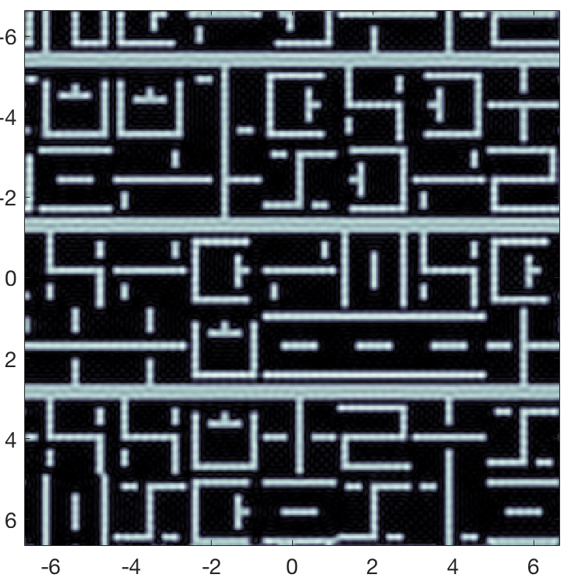
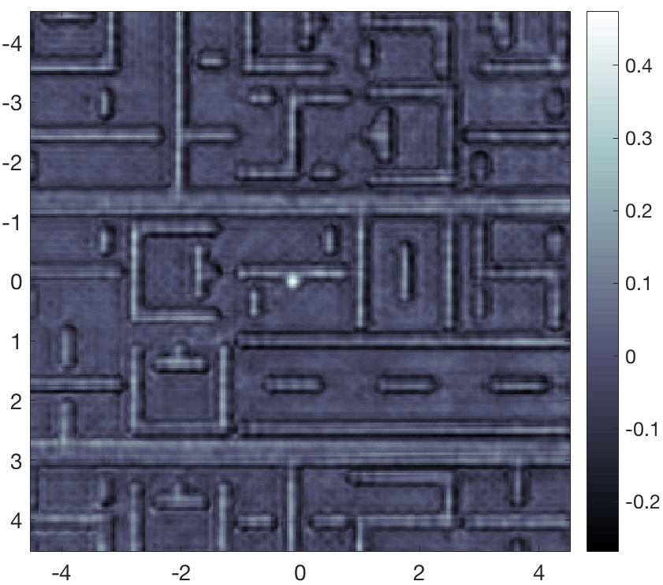
A practical approach: die to database inspection
Comparison between reconstructed image and mask design.
200×200 nm² extrusion defect.
Mask layout
Ideal mask image
Reconstructed amplitude image
Defect map
Apply spatial frequency filter to reticle design.
Calculate the best fitting affine transformation matrix.
Align and compare the images
μm
μm

Slide 7

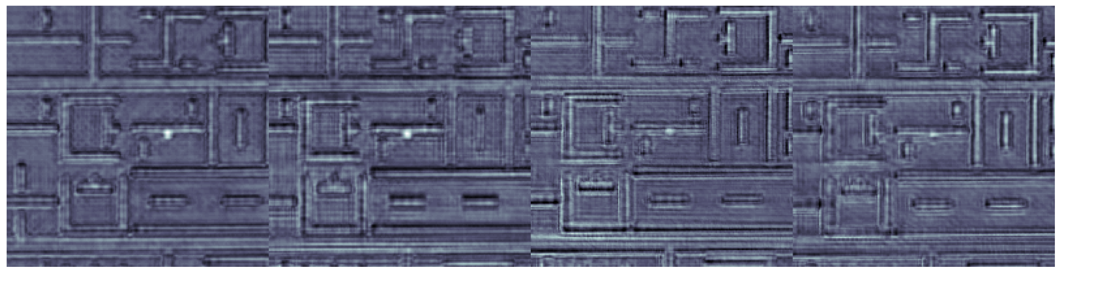
Close to the resolution limit
Defects down to 50×200 nm (on mask) are detected with a significant SNR.
The current resolution limit of RESCAN is 34 nm.
200×200 nm–SNR 7.3
150×200 nm–SNR 6.2
100×200 nm–SNR 5.2
50×200 nm–SNR 6.5
μm
μm
μm
μm
Notes:
To help the defect visualization we can threshold and binarize the images.

Slide 8
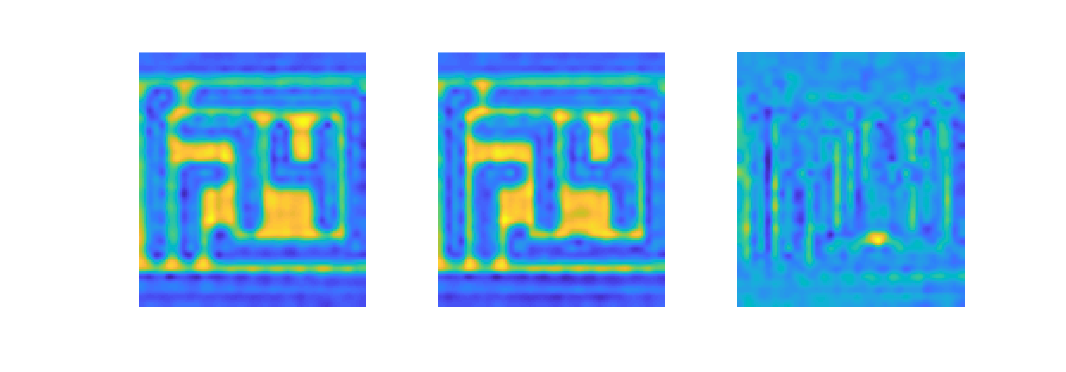
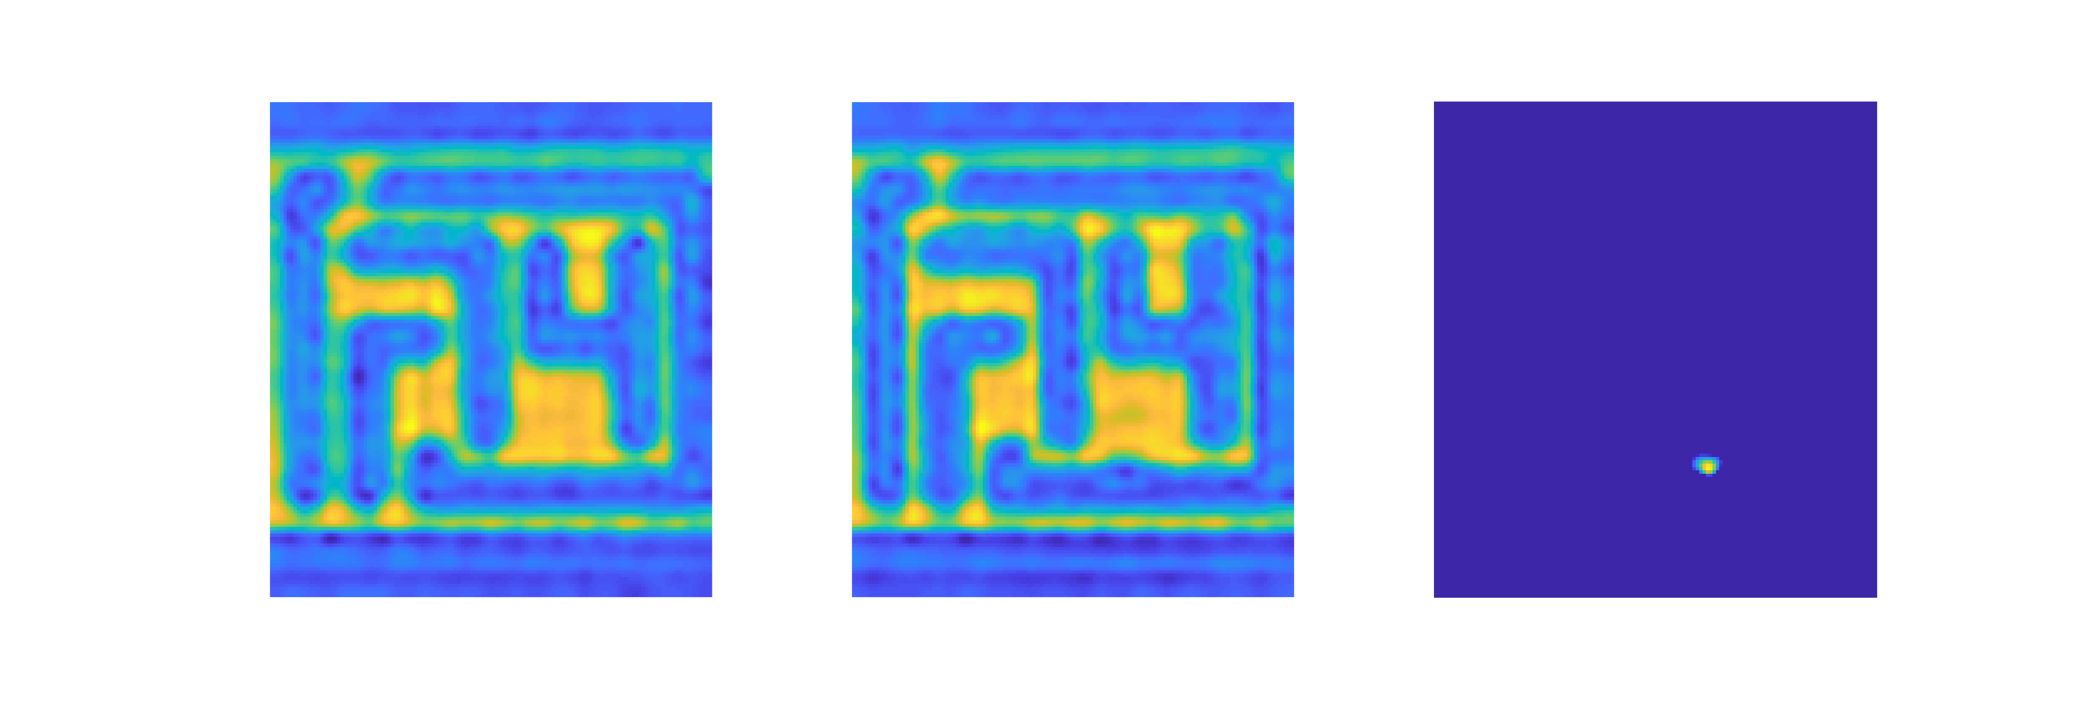


Closer to the resolution limit
Die to die inspection of an industry-standard 70-nm TaBN absorber mask.
SNR: 8.1
CD: 115 nm. Defect size: 141×35 nm

Slide 9
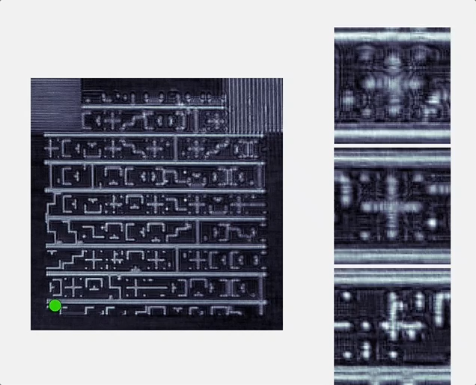
Exploring the through-focus behavior of the sample
Post-processing reconstruction of a tilted sample
Through-focus pattern inspection
Phase structures contrast enhancement
1.5 μm
1.5 μm

Slide 10
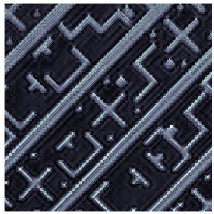
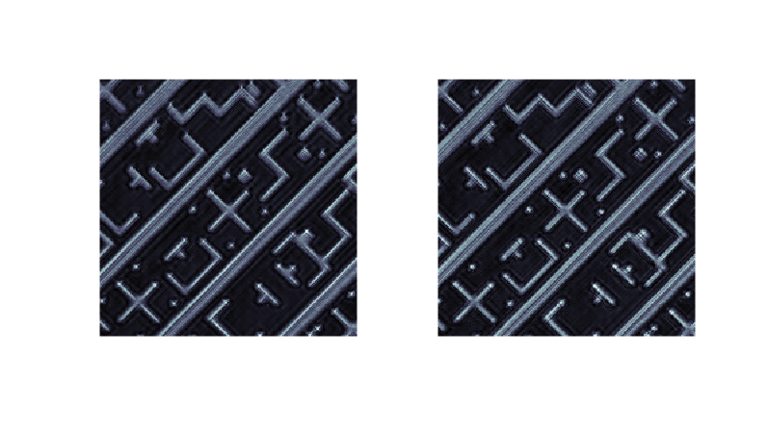
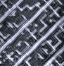
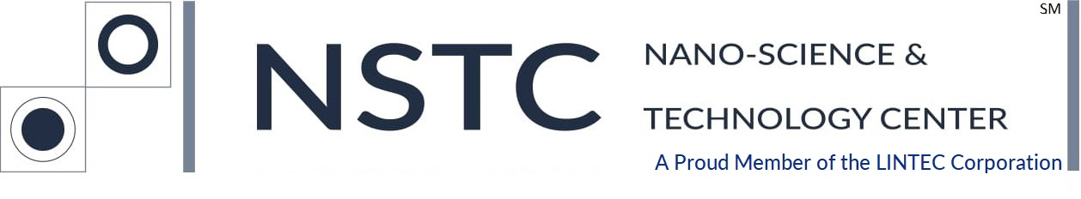
Through pellicle EUV lensless imaging
Pellicles mounted statically: the illumination beam goes through the same spot on the pellicle and the sample moves underneath at a distance of 4 mm.
No pellicle
SW-CNT pellicle
Si₃N₄ membrane(100 nm)
Si₃N₄ membrane
(100 nm)
MW-CNT pellicle
No pellicle
SW-CNT pellicle
MW-CNT pellicle
Pellicle
Reticle
1.5 μm
Pressure: 2⋅10⁻⁸ – 2⋅10⁻⁷ mbar.
Power density_{max}: ~3 W/cm².
λ\dλ : 1500.
The CNT pellicles withstood 6.8h of EUV illumination inside the RESCAN chamber without visible damage and without degradation in the imaging performance.

Slide 11
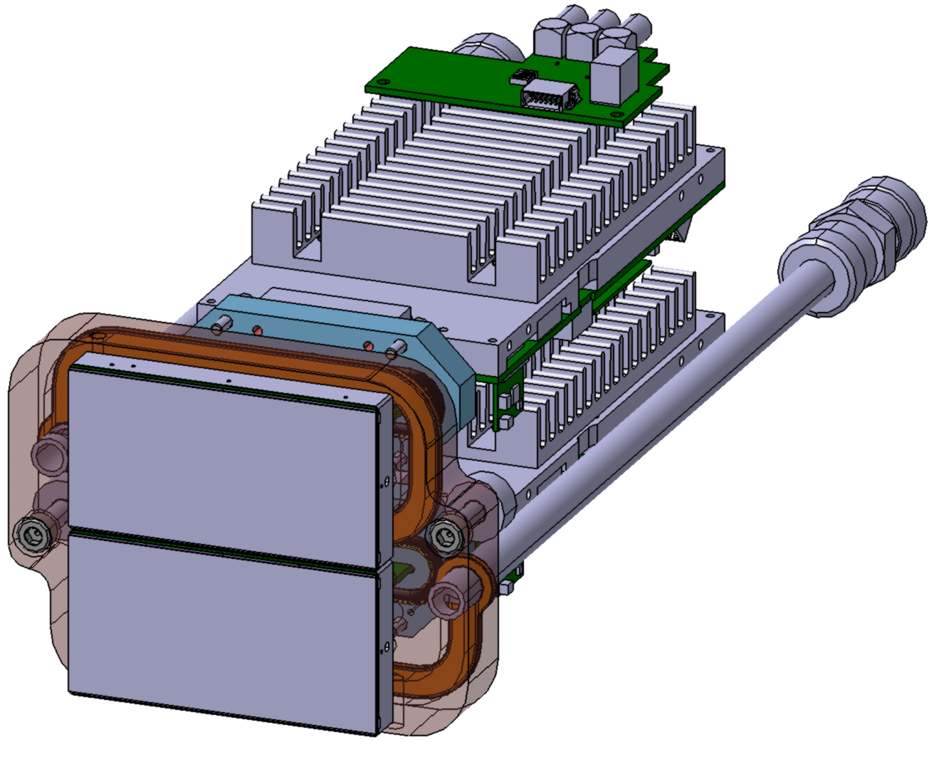
Planned upgrades and roadmap
From EUV CCD to two-modules EUV-optimized JUNGFRAU detector.
EUV CCD
JUNGFRAU
Pixel number: 2048×2048
Pixel number: 1024×512 (1 module)
Pixel size: 13.5 μm.
Pixel size: 70 μm.
Acquisition frame rate: 1 Hz.
Acquisition frame rate: 2000 Hz.
Dynamic range: 16 bit
Dynamic range: 20 bit.
NA: 0.24
NA: 0.4
Large dynamic range
Single acquisition and short exposure time (<0.01 s).
High NA
Resolution limit down to 20 nm.

Slide 12
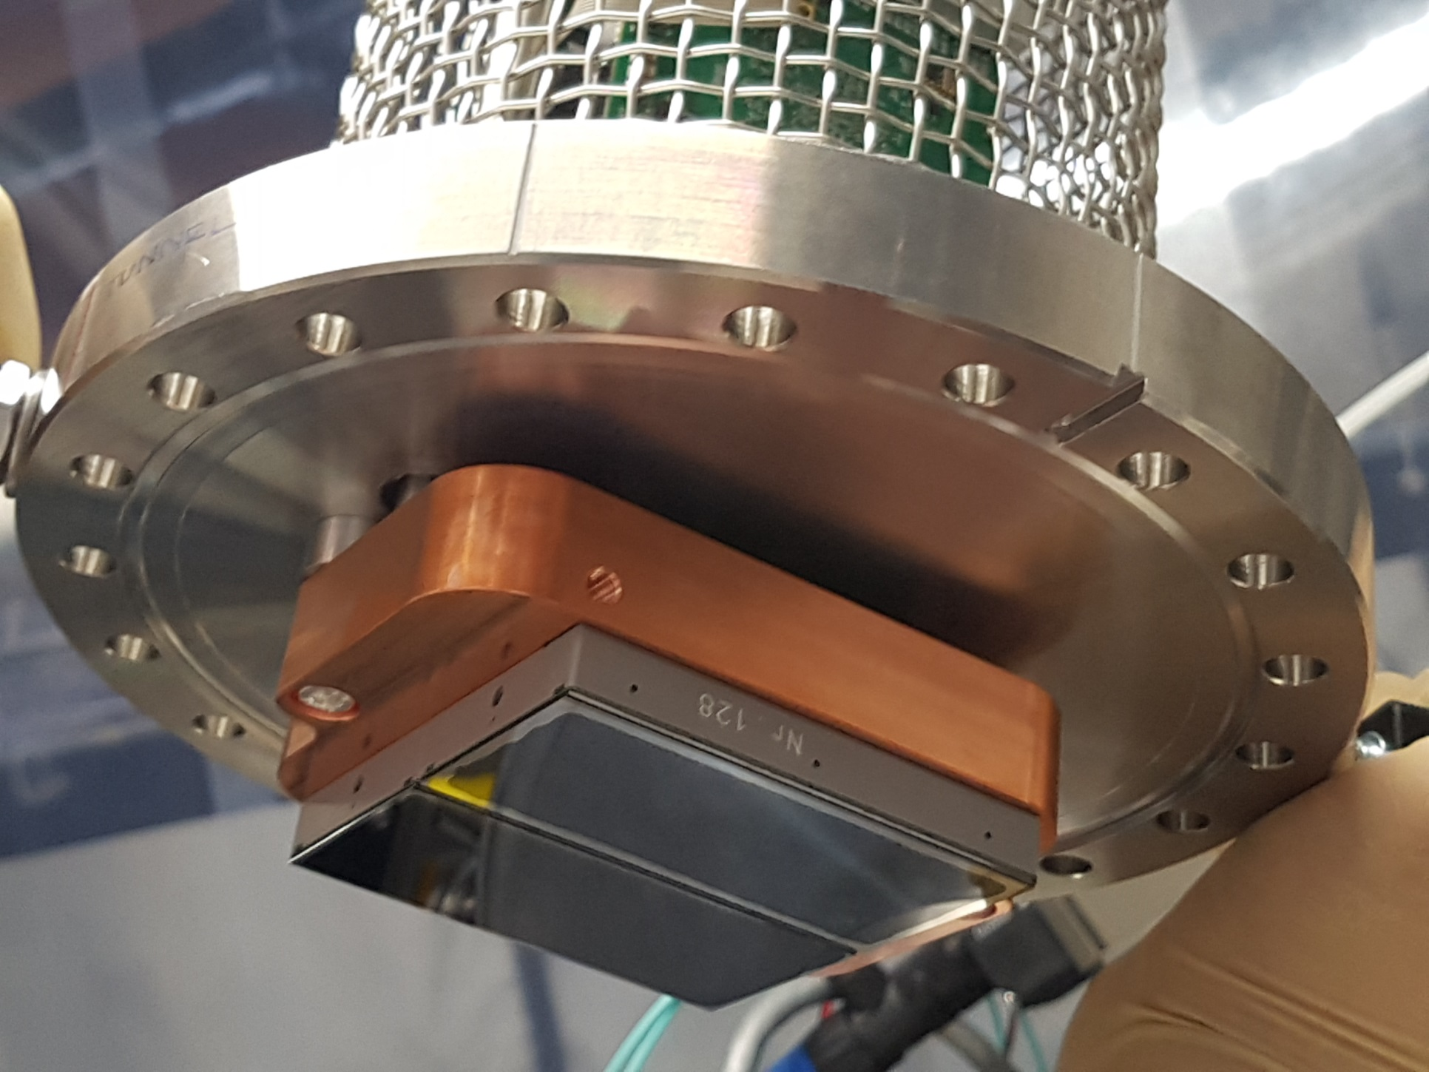
Data acquisition with the JUNGFRAU detector
EUV image profile of the diffraction pattern generated by a grating.

Slide 13
Summary
RESCAN latest results.
RESCAN can effectively map programmed defects on periodic and non periodic patterns.
Die-to-die and die-to-database inspection modes are available.
We demonstrated defect inspection down to 35 nm (on mask) with a high SNR.
We started testing RESCAN with EUV pellicles.
Planned upgrades.
We are upgrading RESCAN with a high NA detector that will enable defect inspection down to 20 nm.
Analysis of programmed phase defects on logic patterns.
Further investigation of the impact of pellicles on defect inspection.

Slide 14
Wir schaffen Wissen – heute für morgen
Acknowledgements
PSI
Michaela Vockenhuber
Marcus Kropf
Aldo Mozzanica
Sophie Redford
Zuhal Tasdemir
Pellicles and membranes
Emily Gallagher (IMEC)
Marina Timmermans (IMEC)
Lintec, NSTC
Canatu Oy
TaBN samples
Shusuke Yoshitake (NFT)
Shingo Yoshikawa, (Dai Nippon Printing Co., Ltd.)

